Slide 1
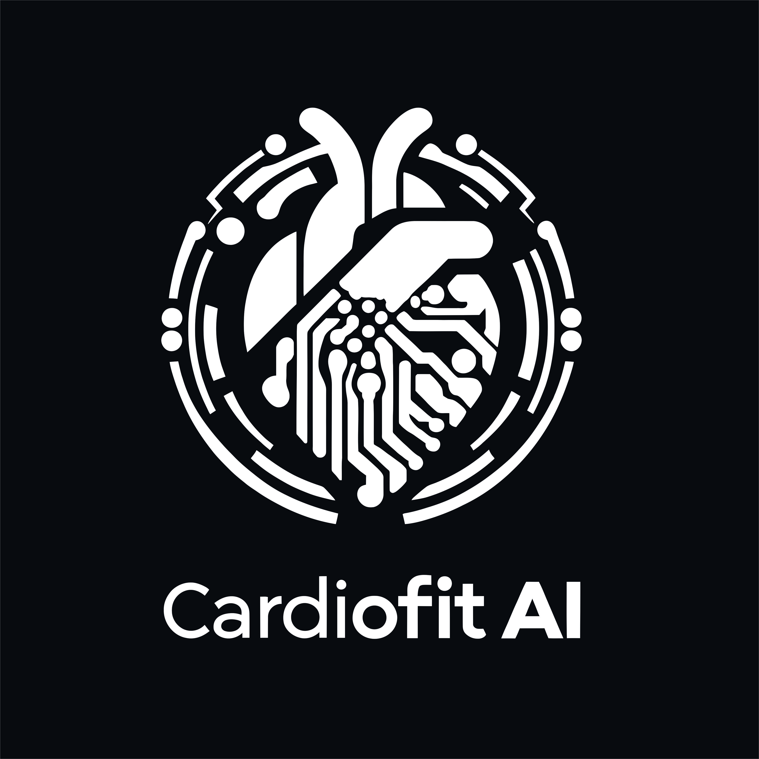
CARDIOFIT AI
R24-019
Notes:
Hello and Welcome to CardioFit AI , A research and innovation project that would revolutionize the field of cardiology.

Slide 2

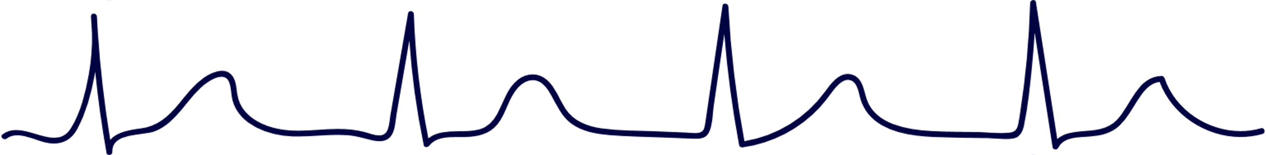
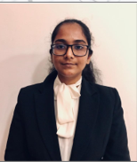
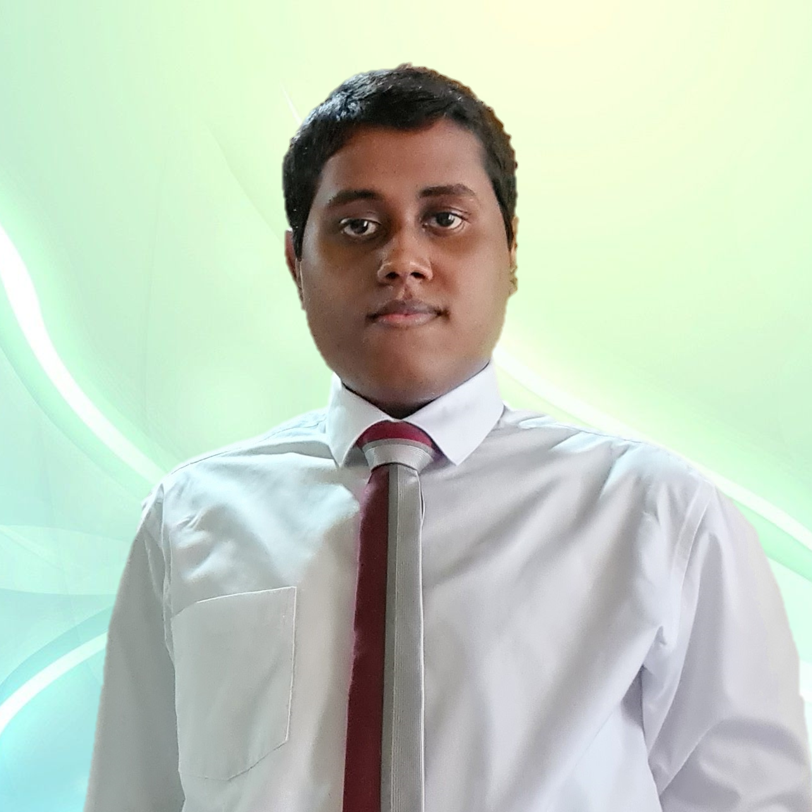
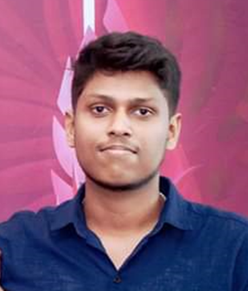
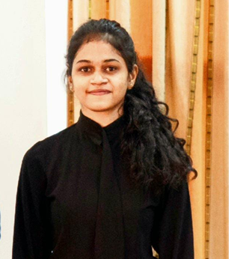
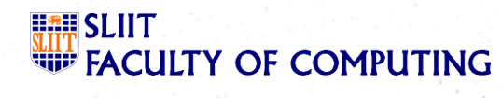
TEAM MEMBERS
Vihansa S.A.S
IT21134180
Senadheera P.V.P.P
IT21126888
Wijeratne D.M.S.D
IT21138386
Christy H.M
IT21127946
5/7/2024
2

Slide 3

INTRODUCTION
Even in an era where technology is at its pinnacle, Millions of human lives are still at risk
Over 17.9 million people die due to cardiovascular diseases annually.
Millions of people are struggling at hospitals due to cardiac arrhythmia.
Critical misdiagnosis of cardiac diseases results in deaths that could have been prevented.
Prominent reason for spread of non communication diseases is unhealthy dietary patterns.
5/7/2024
3
Notes:
Over 17.9 million of people die annually due to cardiovascular diseases. Even in an era where technology is at its pinnacle. Which is why we the members of the cardio Fit AI are here to present a revolutionary software for autonomous detection and prevention of cardiac abnormalities.
Our research problems are,
Inability to Detect 12 lead ECG in real time environment accurately
Inability to pre identify cardiac abnormalities
No proper advice given for consumption of food, unique to ones own medical condition.

Slide 4

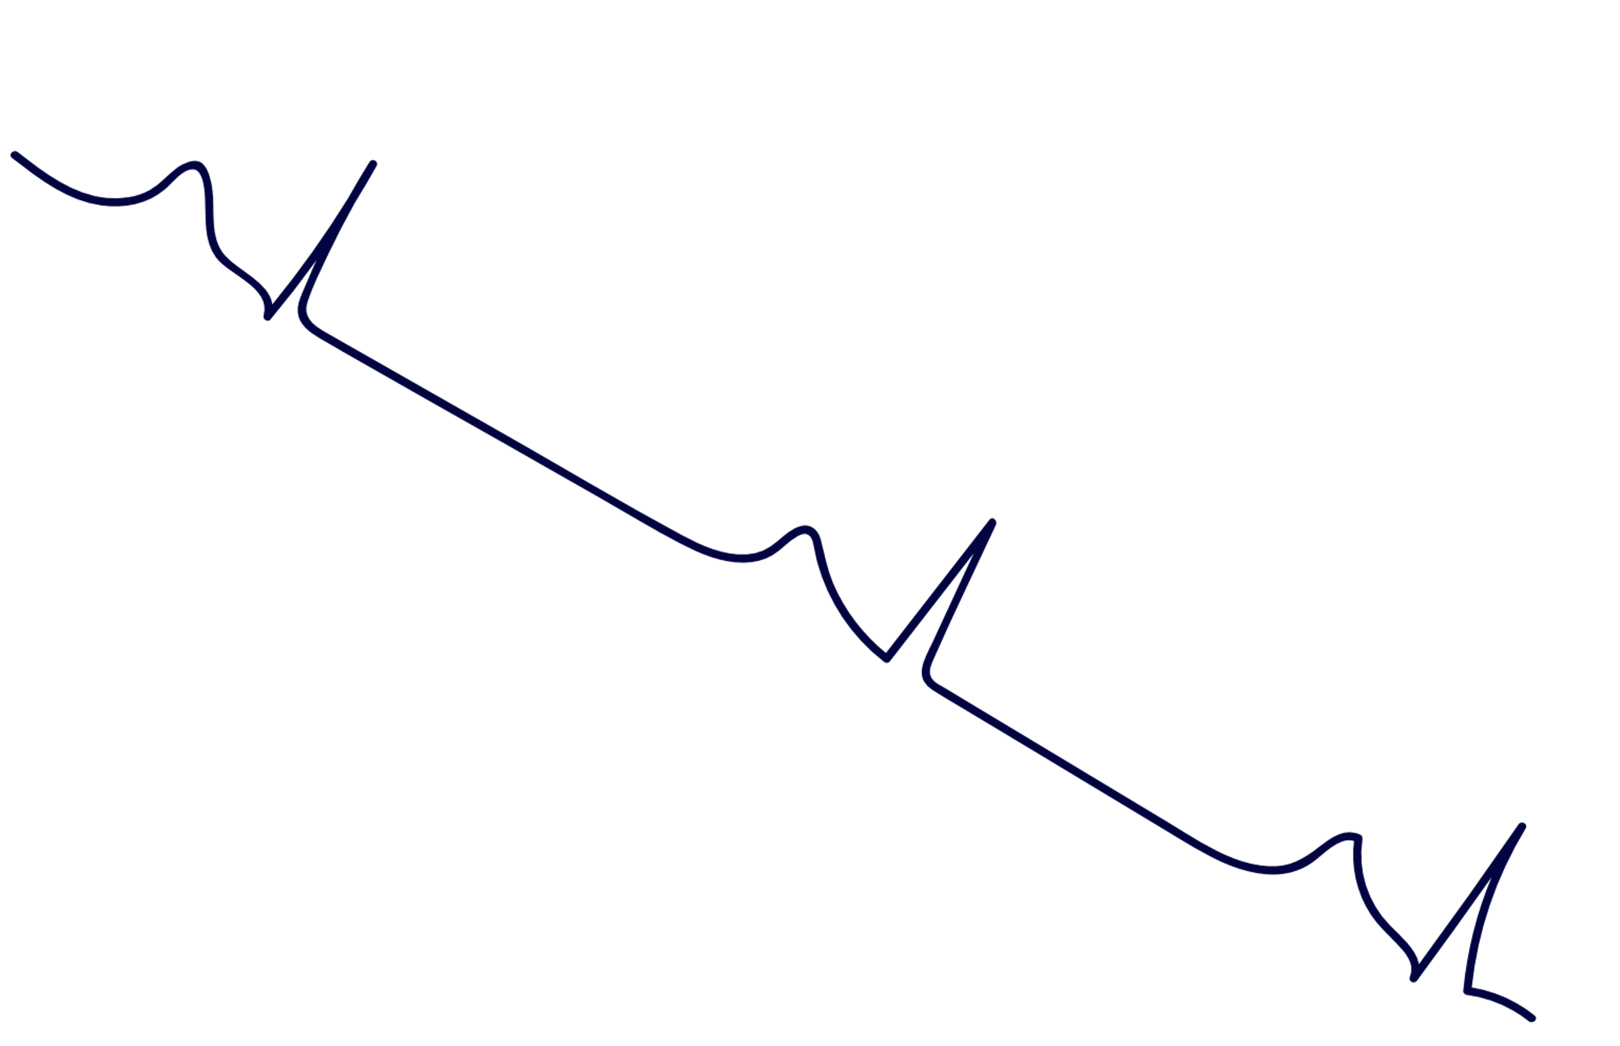

RESEARCH OBJECTIVES
Generation of entire 12 Lead ECG using Lead II ECG signal.
Generation of 12 lead ECG signal with high level of accuracy in comparison to the traditionally obtained standard ECG signal.
Identification of critical cardiac diseases, allowing for informed discussion.
Proposing dietary advice based on patient health records.
5/7/2024
4
Notes:
Our target is to ​
plot a 12 lead ECG with the use of facial analysis and palm analysis. ​
Predict the cardiac abnormality identified​
Generate customized dietary advice considering the patient information

Slide 5
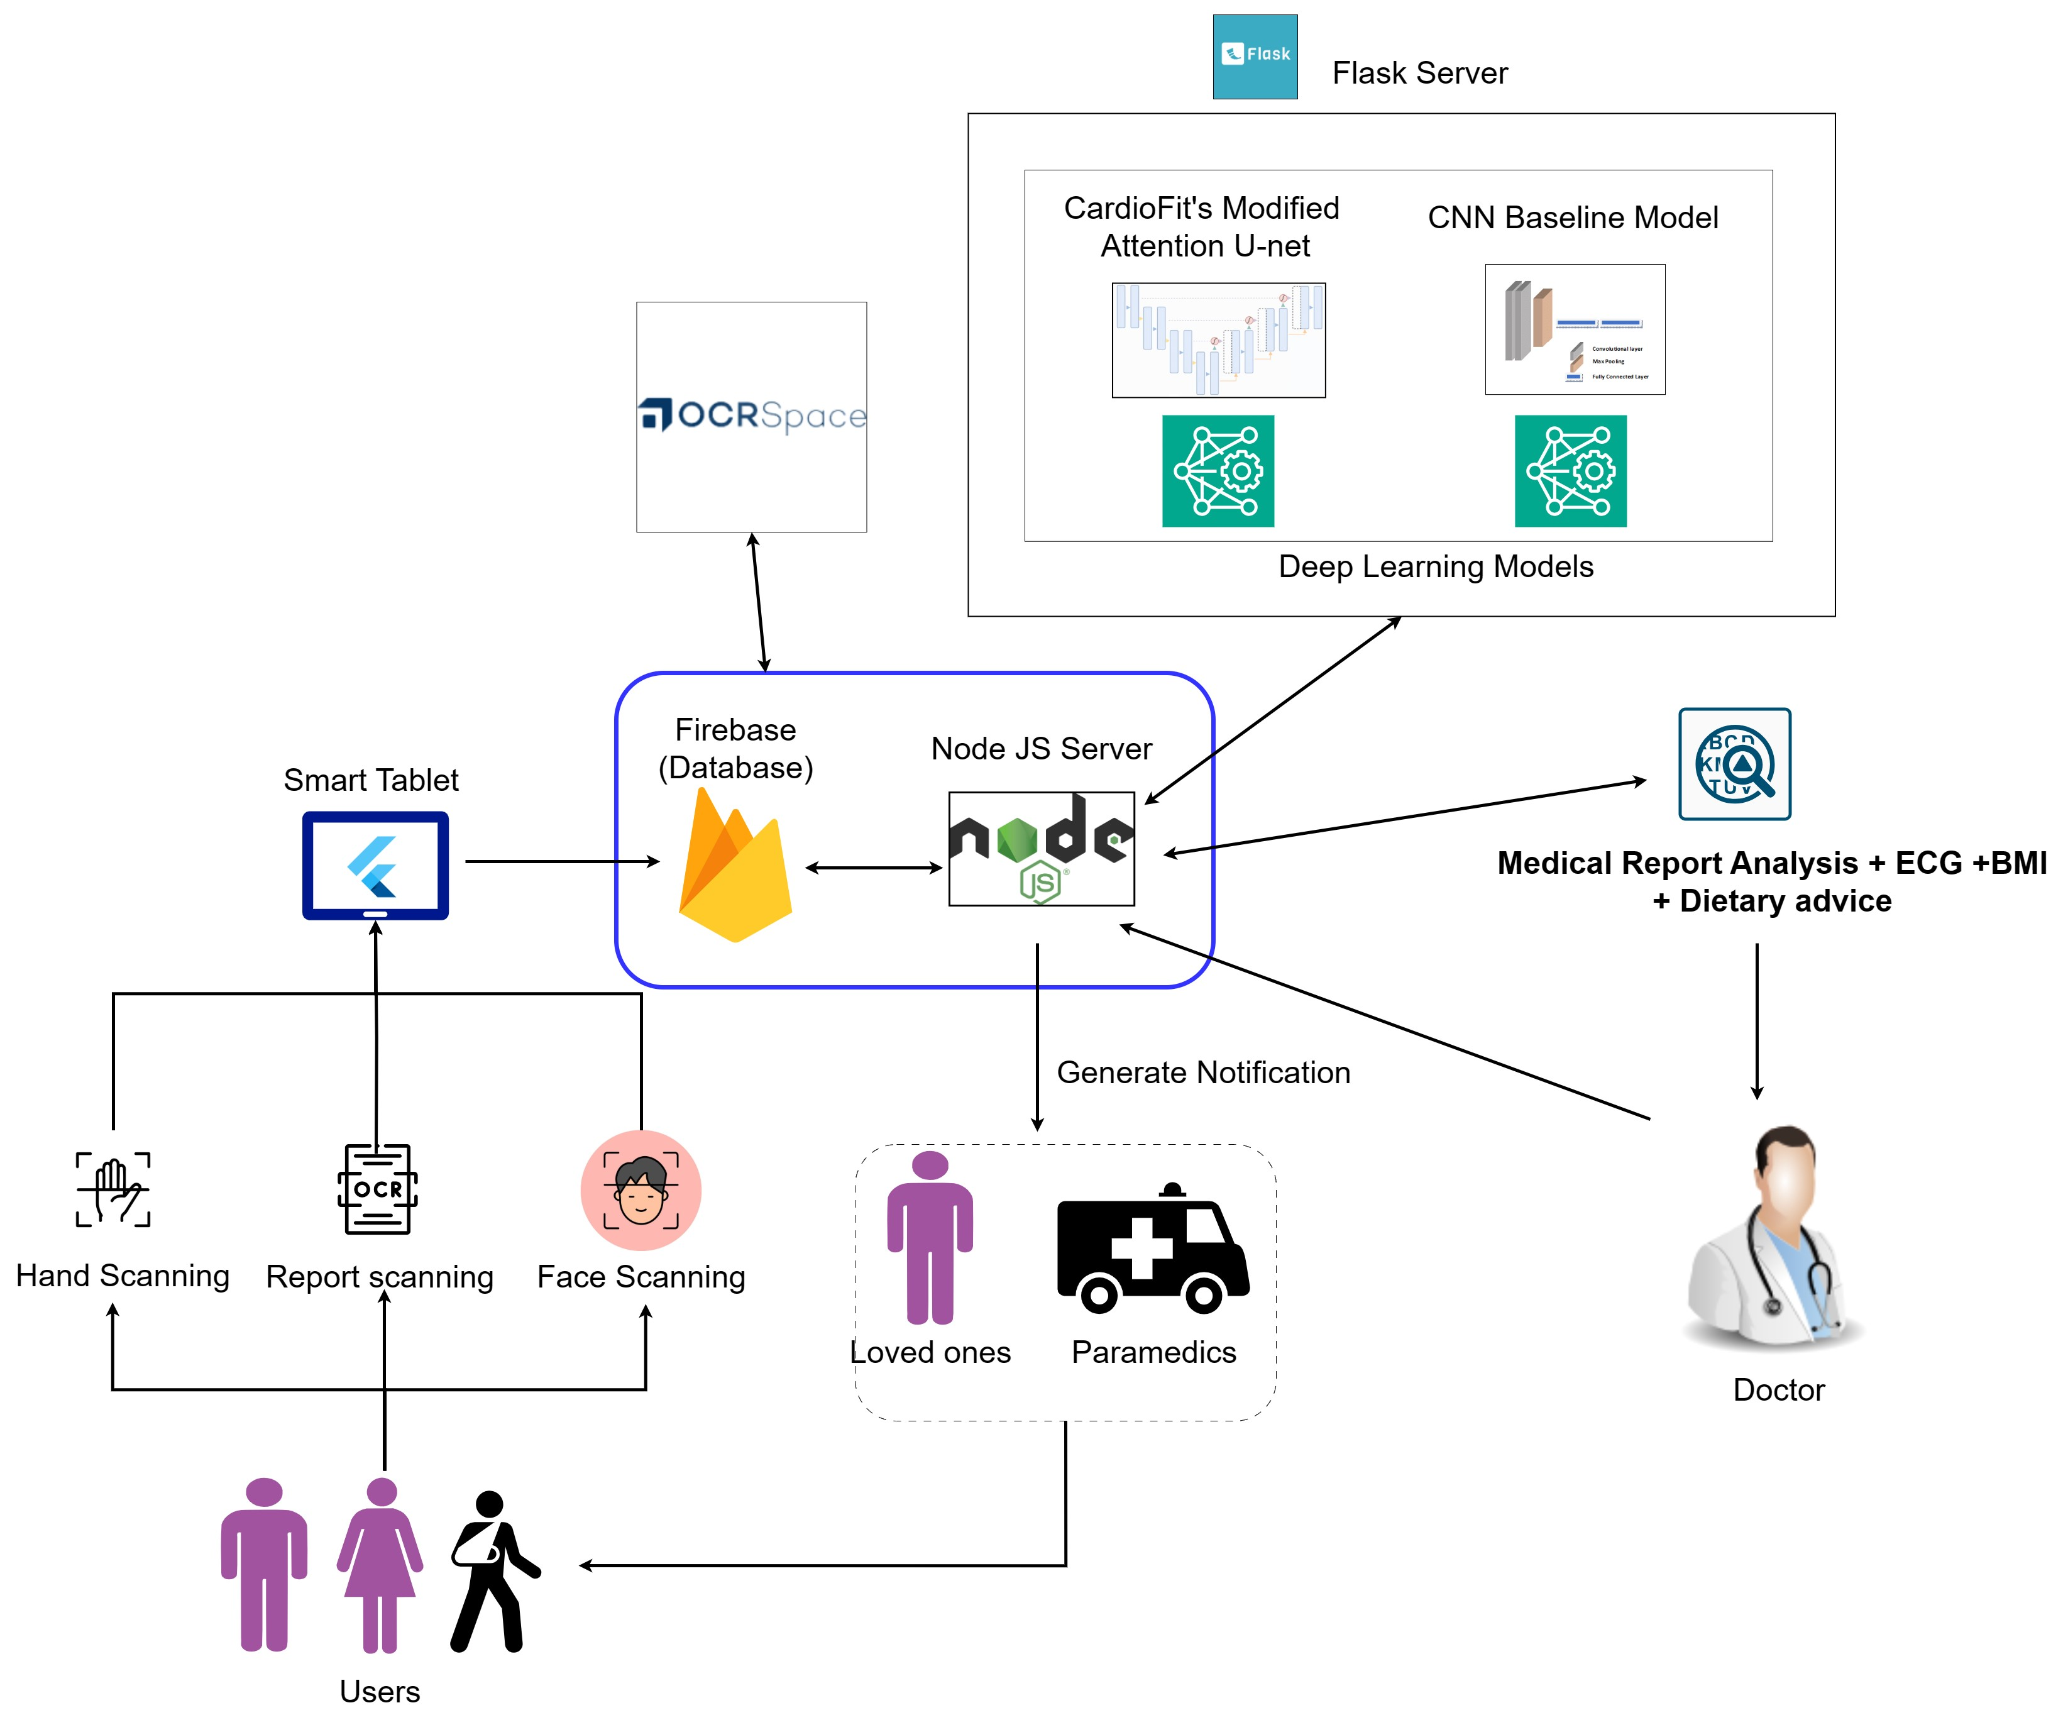
System Diagram
5/7/2024
5
Notes:
This research project is executed in partnership with PulzSolutions Pvt Ltd, a Leading Wearable MedTec Company is Sri LankaMr Pramadhi Atapattu, CEO/Co Founder of PulzSolutions has offered his expertise to ensure that the ECG Capture Technology is used in our project.
Let me now call upon Sathira to explain about his component.

Slide 6
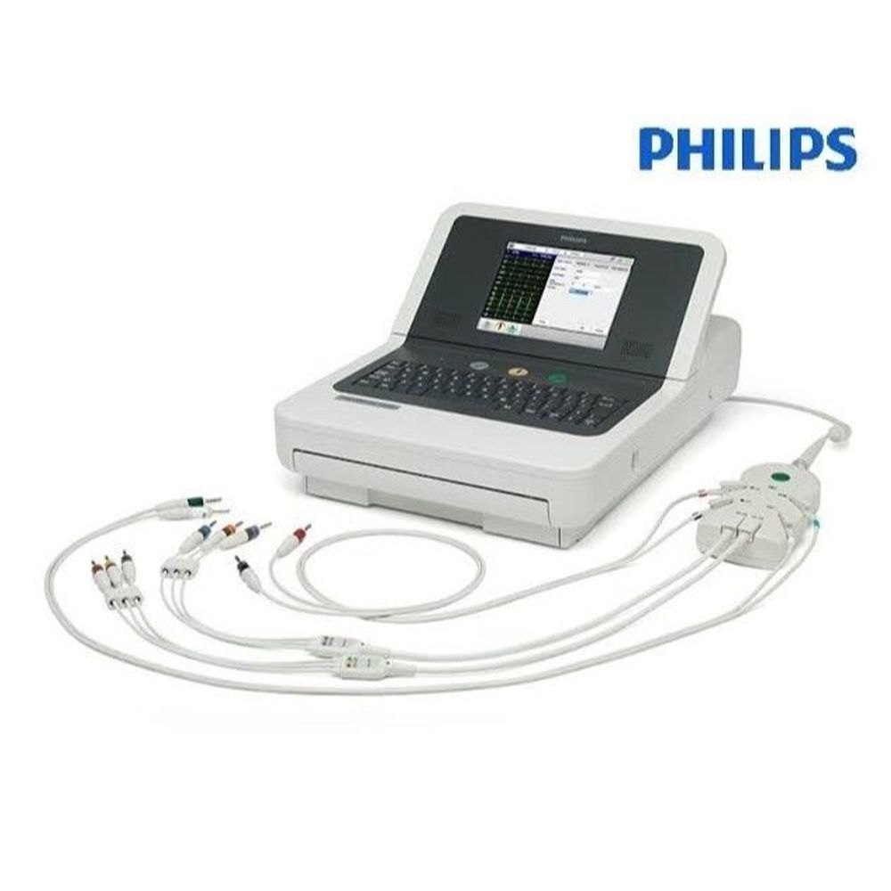
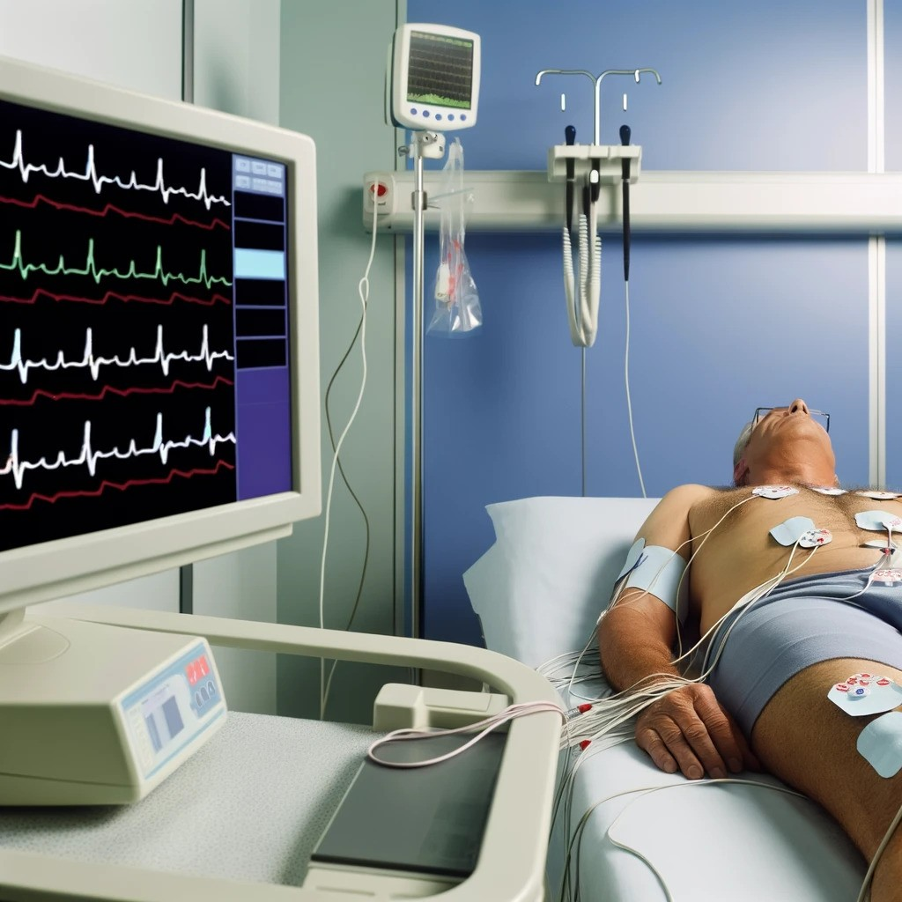
Traditional LEAD ECG Machine
Physical ECG Electrodes
10 Electrodes
Generates 12 ECG Leads
Disadvantages
Costly
Requires maintenance and also ECG Papers to Print it
Requires the patient to lie down.
Requires Medically Trained Cardiographers
Does not generate an Realtime Online Version of the 12 LEAD ECGs (Needs to be Printed in Papers
No Cloud App for Post and Pre Diagnosis

Slide 7
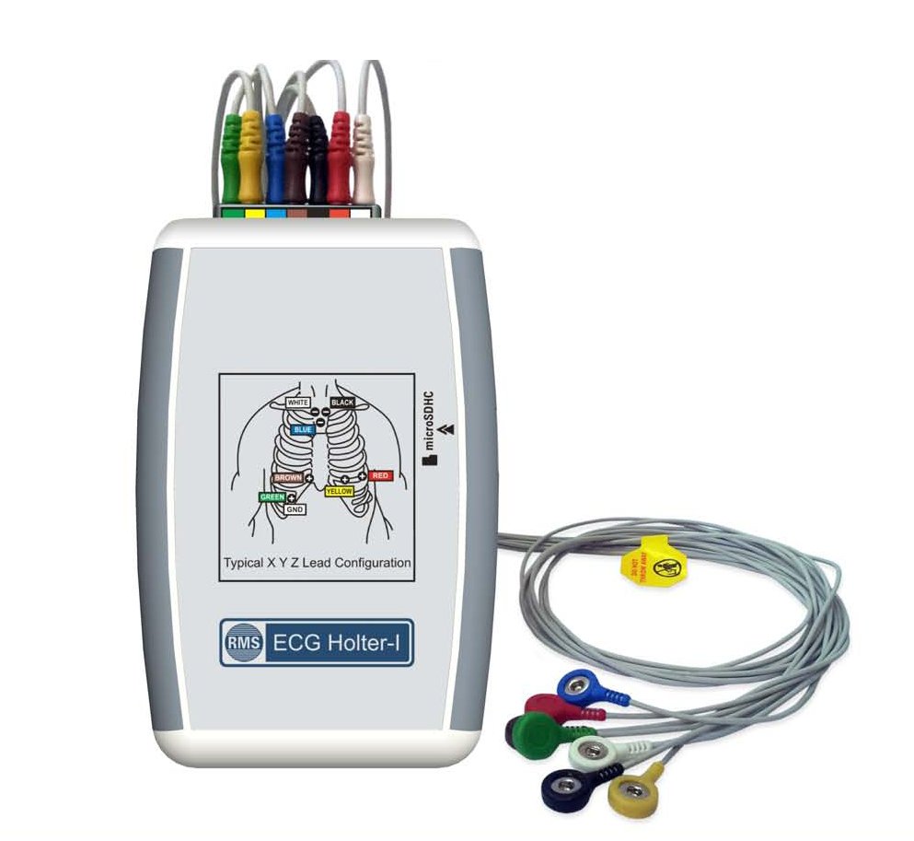
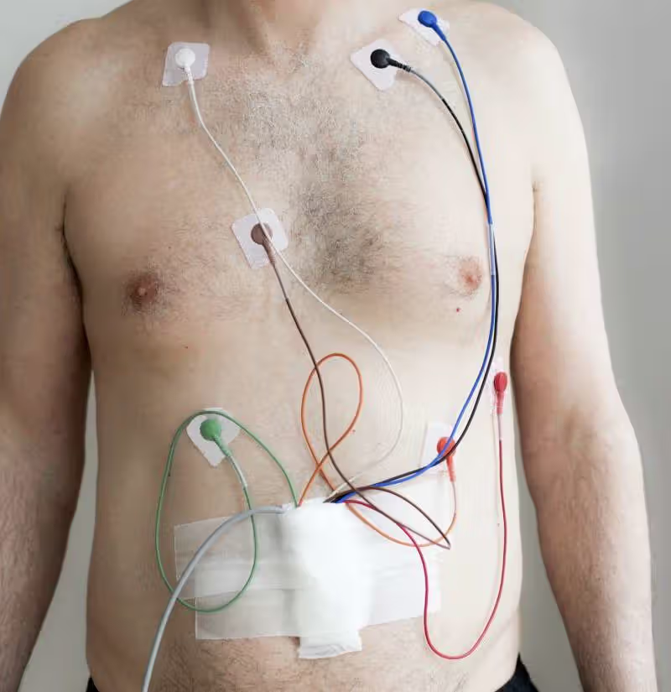
Holter Machine 1 Lead ECG
Physical ECG Electrodes
Generates 12 ECG Leads
Disadvantages
Costly
Requires maintenance and also ECG Papers to Print it
Requires the patient to lie down.
Requires Medically Trained Cardiographers
Does not generate an Realtime Online Version of the 12 LEAD ECGs (Needs to be Printed in Papers
No Cloud App for Post and Pre Diagnosis

Slide 8
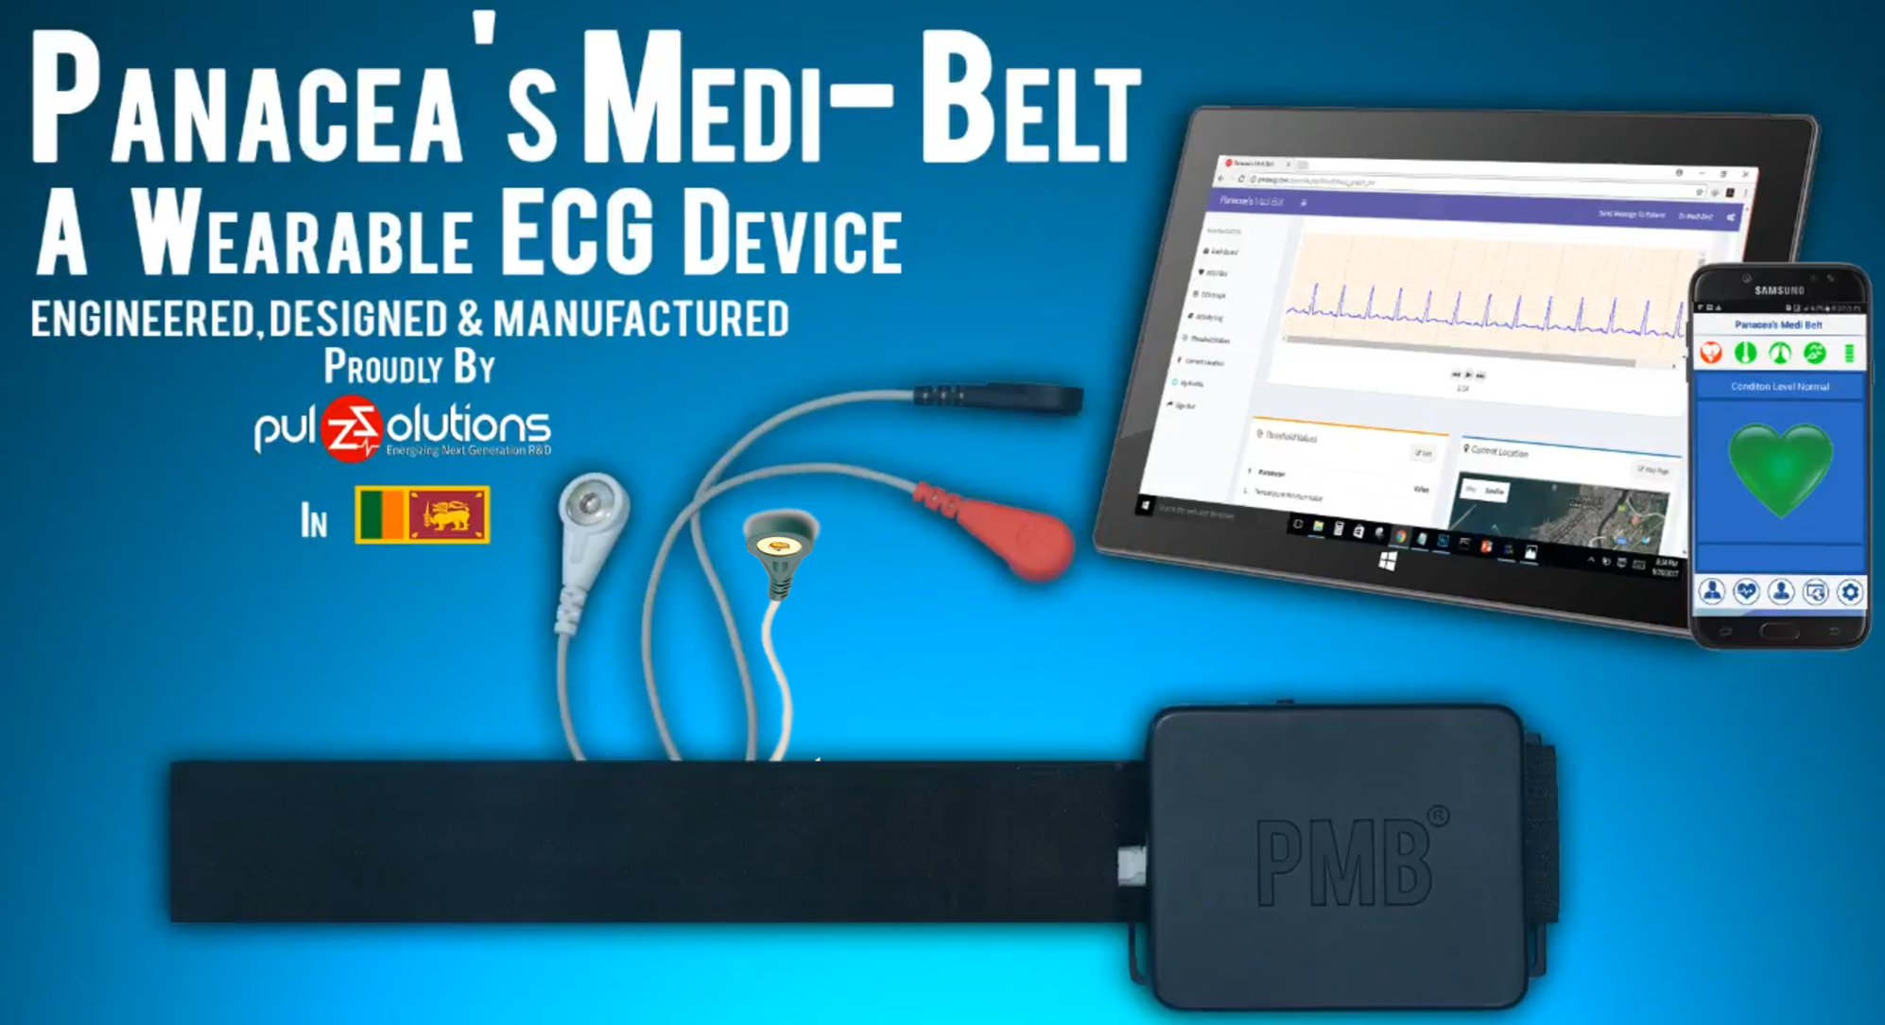
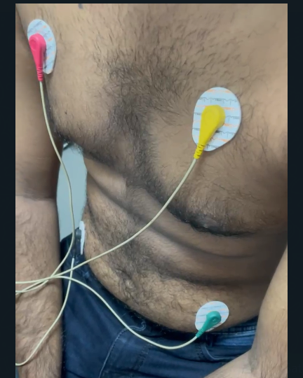
Panacea’s Medi Belt and CardioFit AI
Physical ECG Electrodes
Generates 12 ECG Lead just from 4 Leads
Advantages
Easy to be Applied
Generates ECG on a Realtime Environment
Fully connected to a Cloud Based Repository.
The cloud based data storage is HIPAA compliant
Integrated with

Slide 9
POTENTIAL COMMERCIALIZATION
Executed in partnership with PulzSolutions Pvt Ltd.
PulzSolutions is a leading wearable MedTech company.
Obtained guidance from CEO/Co-founder of PulzSolutions Pvt Ltd – Mr.Pramadhi Atapattu.
5/7/2024
9
Notes:
Our target is to ​
plot a 12 lead ECG with the use of facial analysis and palm analysis. ​
Predict the cardiac abnormality identified​
Generate customized dietary advice considering the patient information

Slide 10

IT21138386 | Wijeratne D.M.S.D
Specialization : Software Engineering
IT21138386 | Wijeratne D.M.S.D | R24-019
Notes:
Good evening, dear panel, Today I will be presenting to you something which might change the way we capture an ECG signal forever.
Change slide

Slide 11
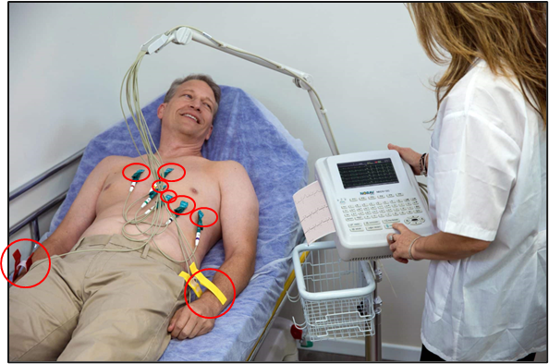
Background
Importance of ECG
Problems with ECG
Tells us about our heart’s health.
Considered as the Golden Standard [1].
Cardiac diseases are the number 1 cause of death in the entire world [2] claiming 17.9 million lives annually.
Having to lie down and possibly take of your top.
Having numerous wires attached all over your body.
Source : - 15-lead Resting ECG vs. 12-lead Resting ECG: What's the Difference? - Norav Medical
11
IT21138386 | Wijeratne D.M.S.D | R24-019
5/7/2024
Notes:
For those of you who may not know, an Electrocardiogram also known as ECG or EKG, is a reading which tells us about our heart’s health. Now as you may already know, in order to capture a traditional 12 Lead ECG signal, there are various cumbersome tasks to be followed.
They are:
Having to lie down
take of your top.
Have numerous wires attached all over your body.
This all sounds very troublesome right? So why do people go through all this trouble? The reason is because the 12 Lead ECG is considered as the golden standard when it comes to diagnosing the heart’s health. Just Imagine, a world, where the entire 12 Lead ECG is generated but without going through all this trouble.
This is where our Novel Innovation comes in. Simplifying this rather troublesome process into something which is much more easier to carry out, while still maintaining the quality of the signals captured is what my component focuses on.
Streamlining this process is of utmost importance because according to the World Health Organization, cardiac diseases are the number 1 cause of death in the entire world, claiming a shocking 17.9 million lives each year.
However, in order better understand the role of my component plays, let’s take a look at what the 12 Lead ECG consists of.
Change slide

Slide 12
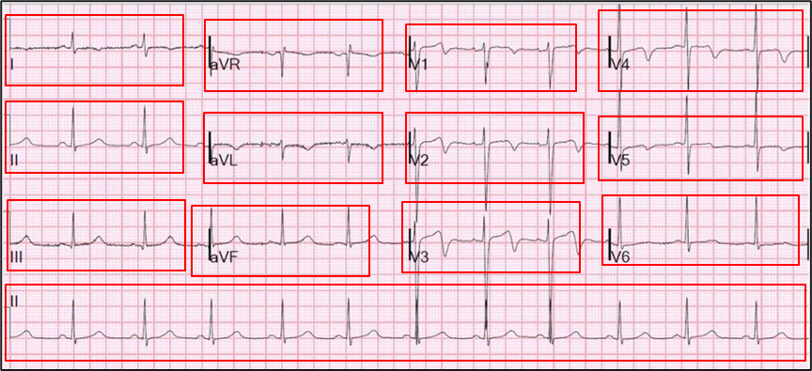
About the 12-Lead ECG
Measures heart’s electrical activity.
Consists of 12 different views of the heart’s electrical activity.
10 different electrodes placed throughout your body.
Source : - How to Read an EKG (ppemedical.com)
12
IT21138386 | Wijeratne D.M.S.D | R24-019
5/7/2024
Notes:
As the name suggests the 12 lead ECG reading consists of 12 different readings of the heart’s electrical activity. And in order to measure these 12 readings, you need to have 10 different electrodes placed throughout your body.
However, what I have done is, I have taken the lead II ECG signal, and I have used that to reconstruct the rest of the 11 ECG signals using a deep learning framework known as the CardioFit’s modified Attention U-net.
Change slide

Slide 13
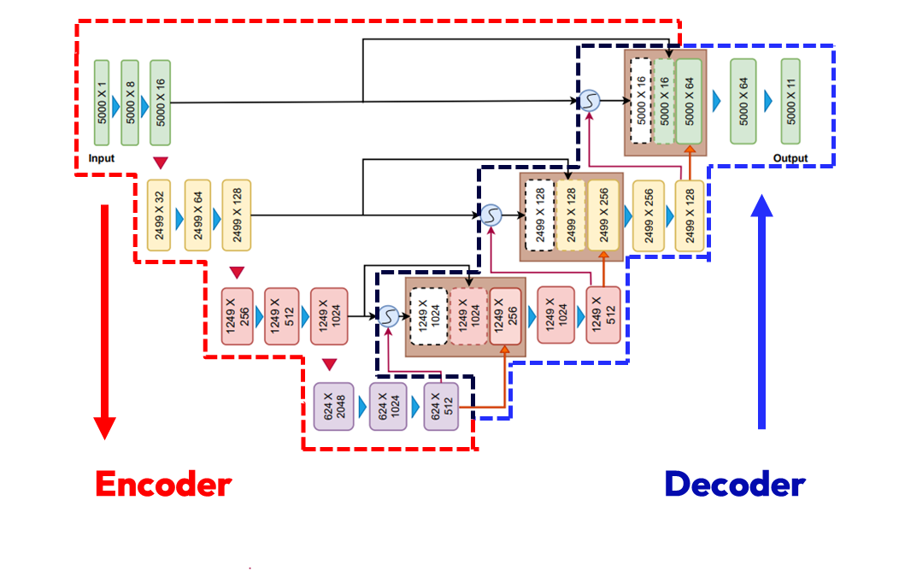
CardioFit’s Modified Attention U-Net
Main Components
Encoder
Decoder
Source :- https://ieeexplore.ieee.org/document/10191213
13
IT21138386 | Wijeratne D.M.S.D | R24-019
5/7/2024
Notes:
So, what is this CardioFit’s modified Attention U-net? Well, first of all, this framework can be split into 2 main components known as the encoder and decoder sections. And at its core, the modified attention u net is combination of several 1-dimensional convolutional layers shown (highlighting 1D convolutions) by the blue arrows heads circled in the image.
Change slide
Now what my component will be focusing on is strictly the Encoder section of this framework.

Slide 14
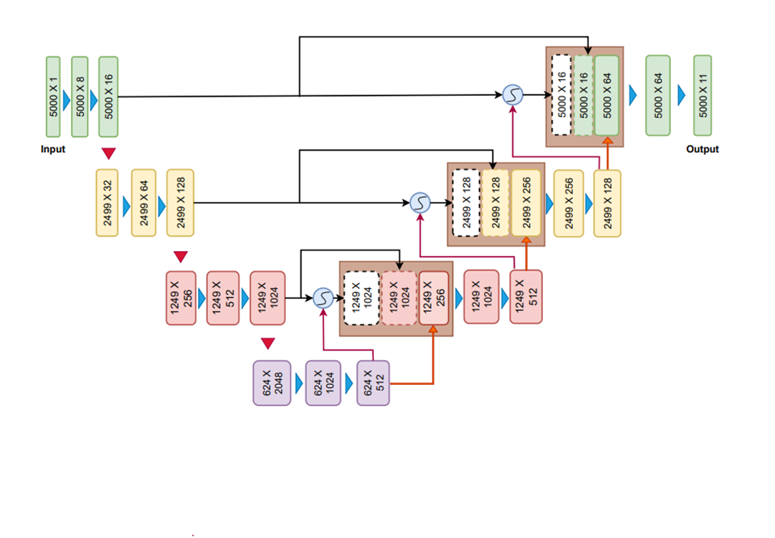
Encoder
Decoder

Slide 16
Encoder
Functionality
Extracts most relevant features needed for reconstructing the remaining ECG signals
Key components
1D Convolution with ReLU activation
1D convolution with Batch Normalization
Skip connections
Source : - https://ieeexplore.ieee.org/document/10191213
16
IT21138386 | Wijeratne D.M.S.D | R24-019
5/7/2024
Notes:
So, what exactly does this encoder section do? (Moving arrows) At a high level what the encoder section does is it takes the lead 2 ECG signal as an input, and it strips down the signal to the most relevant features that are needed for reconstructing the remaining ECG signals.
The features that are extracted mainly includes the edges and repeating signal patterns such as the QRS complex.
Change slide

Slide 17
Encoder
Functionality
Takes input Lead II
Create feature maps
Apply Rectified Linear Unit (ReLU) Activation
Sends skip connection to decoder section
Source : - https://ieeexplore.ieee.org/document/10191213
17
IT21138386 | Wijeratne D.M.S.D | R24-019
5/7/2024
Notes:
Now let’s take a closer look at the Encoder section.
(Highlight 1st layer)
In the first layer, there are two 1D convolution layers. What each convolution layer does is, it creates feature maps from the input Lead II ECG signals.
And in each convolution layer there is a relu activation. relu activation is a function that allows the model to learn the complex nonlinear relationships between the Lead II ECG signal and the other 11 ECG signals.
(Show skip connection)
Then the output feature maps we get is saved for later using something called as skip connection, this is a crucial step that is very important during the decoding process, however I will get to why it is important at the end.
(Change slide)

Slide 18
Encoder
Functionality
Down sample input data through batch normalization
Reduce ECG signal length via strided convolutions.
Developed from Scratch!
Source :- https://ieeexplore.ieee.org/document/10191213
18
IT21138386 | Wijeratne D.M.S.D | R24-019
5/7/2024
Notes:
Moving onto the next layer, the output is sent through a 1D convolution with BatchNormalization. This convolutional layer is indicated by the red downward arrow head.
(show batchnorm)
What batchNormalization does is it downsamples the input data by reducing the length of the ECG signal through strided convolutions. Doing so will help speed up and stabilize the training process by reducing the computational complexity of the network.
And then yet again the input goes through two more 1D convolutions with relu activation to create more feature maps.
(Show second set) This process is repeated 2 more times in this section, and then again in this section (show other set). So, in total, the input signal has been downscaled thrice.
Now the input signal has been filtered down all the way to only include the utmost important features for the reconstruction of the remaining ECG leads. However, during the down sampling process since the signal is shortened, there is a data loss. This is where the skip connections become useful.
(show skips)
The reason for this to exist is in order to counteract the data loss caused during the down sampling of the input signal by providing information from earlier layers.
Now It is important to note that this architecture is based on a study done by a group of researchers, however even though this architecture is provided, the source code for this model was not publicly available and we had to develop it from scratch.

Slide 19
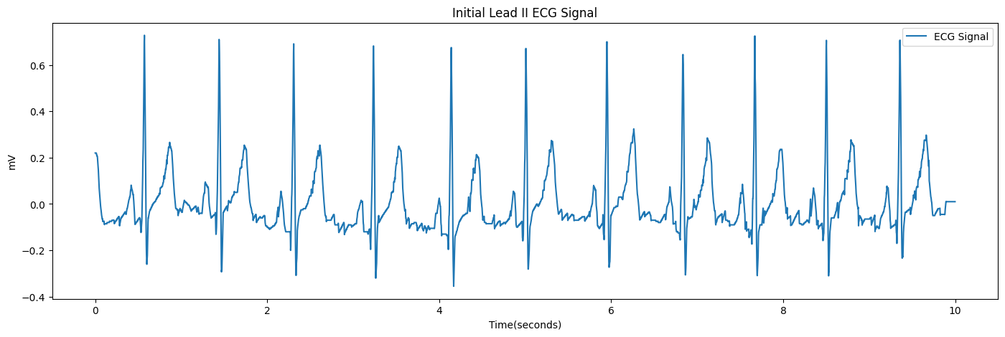
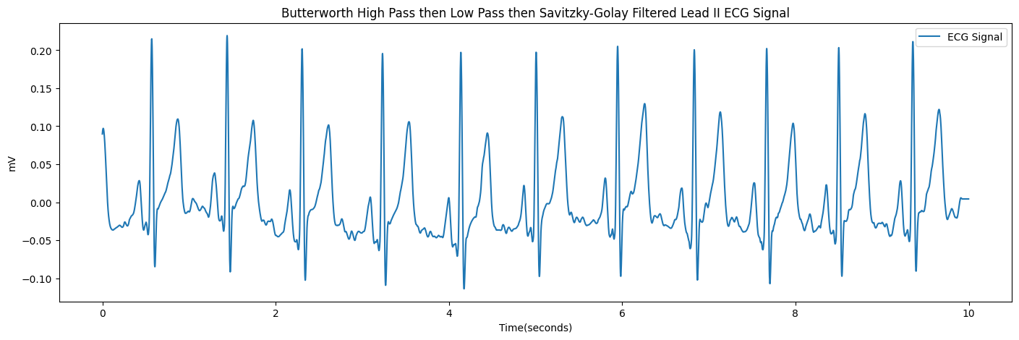
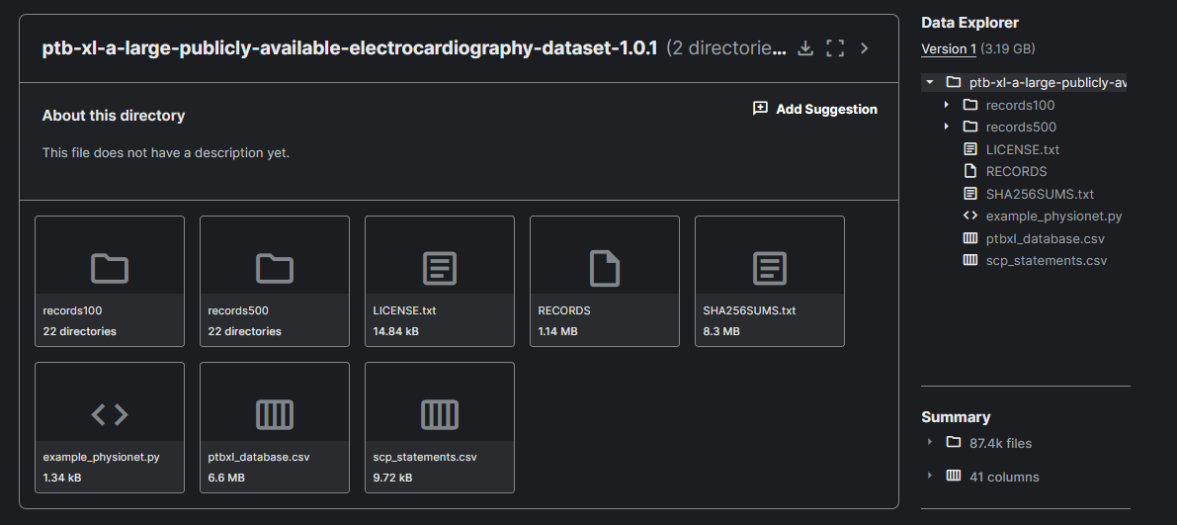
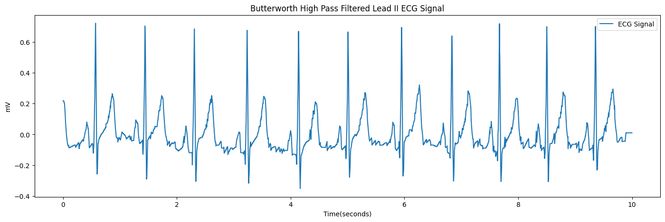
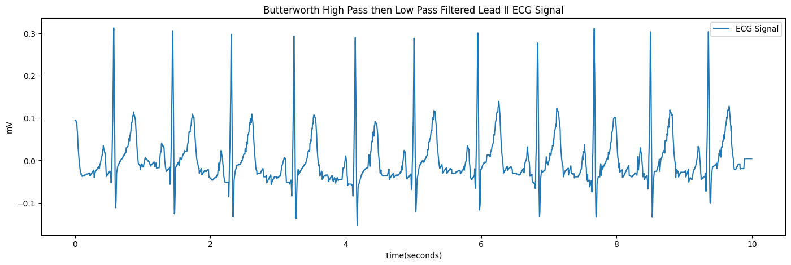
Data collection and Pre-processing
PTB-XL Dataset
Filtering signals
21799 clinical 12-lead ECGs from 18869 patients
(b) Unfiltered Lead II ECG signal
(e) Savitzky-Golay Filtered Lead II ECG signal
(c) Butterworth High Pass Filtered Lead II ECG Signal
(a) Data collection
(d) Butterworth Low Pass Filtered Lead II ECG signal
19
IT21138386 | Wijeratne D.M.S.D | R24-019
5/7/2024
Notes:
Inorder to make accurate predictions, this model was trained using a one of the largest publicly available ECG datasets consisting of 21799 clinical 12-lead ECGs from 18869 patients.
Once the dataset was acquired, inorder to remove noise from the input Lead II ECG signal, we used various filter. Thanks to these filters Here we can observe a progressive decreasing of the noise in the signal as a visual representation.
Change slide

Slide 20
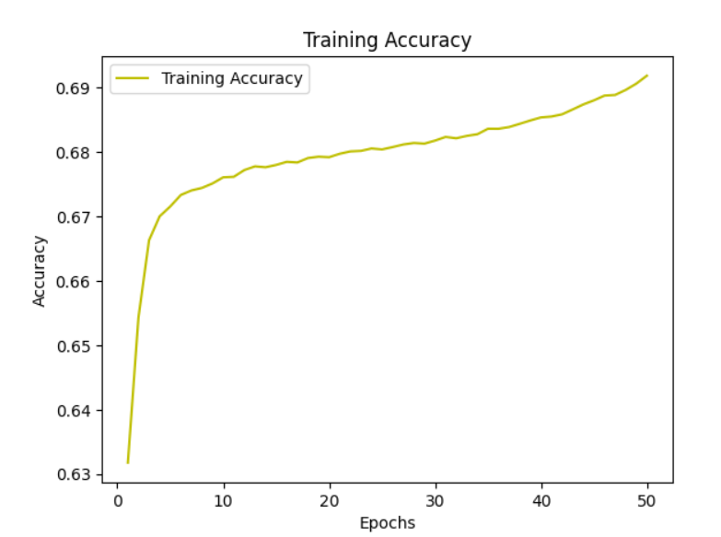
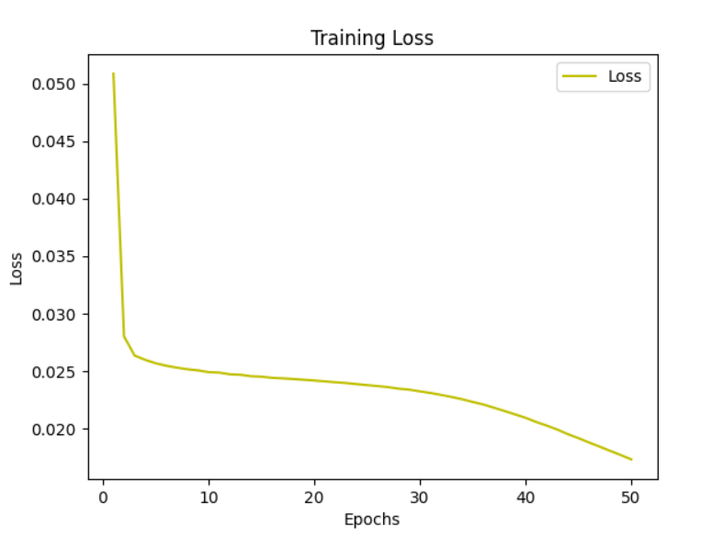
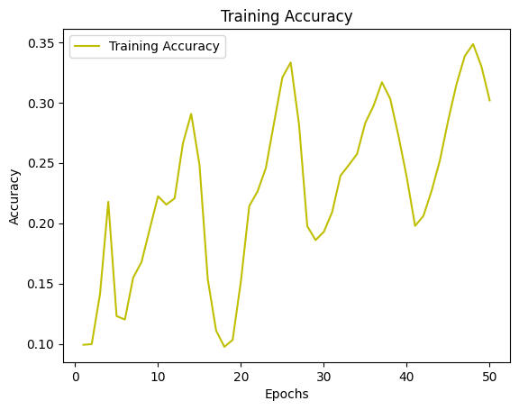
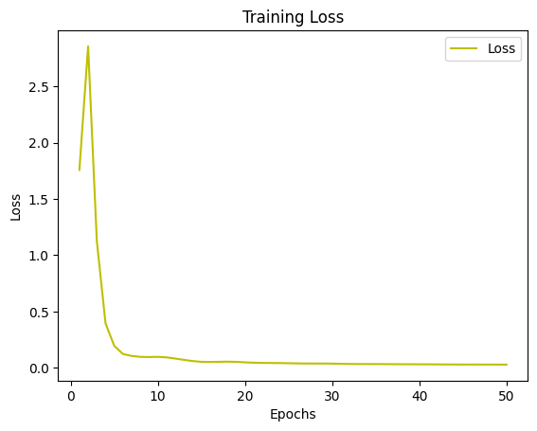
Data visualization and Pre-processing
CardioFit’s Modified Attention U-Net - Model training
With normalization
Better accuracy
Lower training loss
(a) Training accuracy after normalization
(b) Training loss after normalization
Without normalization
Poor accuracy
Higher training loss
(a) Training accuracy before normalization
(b) Training loss before normalization
20
IT21138386 | Wijeratne D.M.S.D | R24-019
5/7/2024
Notes:
However, filtering the leads was not sufficient enough to produce good results at first. We also had to normalize the data to obtain best possible results. These graphs shows the improvement in training accuracy in both scenarios.
Change slide

Slide 21
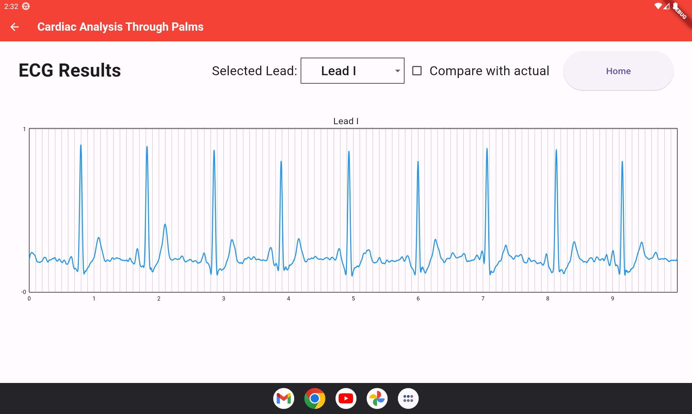
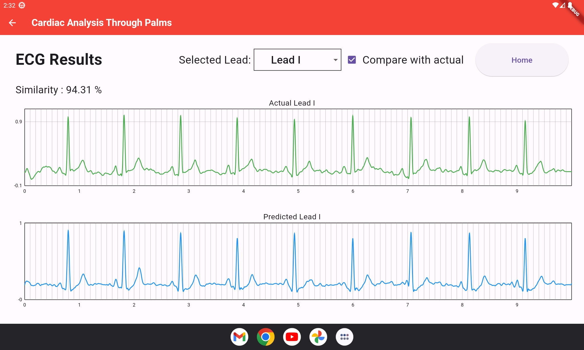
Displaying of results in mobile application
CardioFit’s Modified Attention U-Net - Results
(a) Reconstructed Lead I ECG signal
(b) Similarity of reconstructed Lead I against actual Lead I
5/7/2024
21
IT21138386 | Wijeratne D.M.S.D | R24-019
Notes:
This next slide is a visual plot of the reconstructed Lead I as well, as the similarity between a reconstructed Lead I ECG signal against the actual Lead I signal, and as stated there is a 94% similarity between the 2 signals.
Now you must be thinking, ‘ok this is all great’ but to do all this, we still need Lead II as an input right? So where is that coming from? Well typically, Lead I, II and III can be obtained using 3 electrodes.
However, this is still similar to the troublesome 12 Lead ECG acquiring process, the only difference being the lesser number of electrodes attached to our body. Well, that is addressed by the rest of my component.
I am also working on obtaining a Lead II ECG signal based on the color changes of the facial skin. So, Let’s go ahead and take a look at how all this will come together now.
(Change slide)

Slide 22
Methodology
5/7/2024
22
IT21138386 | Wijeratne D.M.S.D | R24-019
Notes:
Initially the user will take a facial recording using a smart tablet. This recording will be used to isolate only the facial region since that is the region on interest. The isolated facial video will then be passed through CNN layers to extract relevant features that have a relationship with the Lead II ECG signal. Then these features will be used to generate a Lead II ECG signal using a Generative Adversarial Network. Once the Lead II ECG signal is obtained, it will be passed to the CardioFit’s Modified Attention U-net framework which will reconstruct the remaining 11 ECG signals.
Chang slide

Slide 23
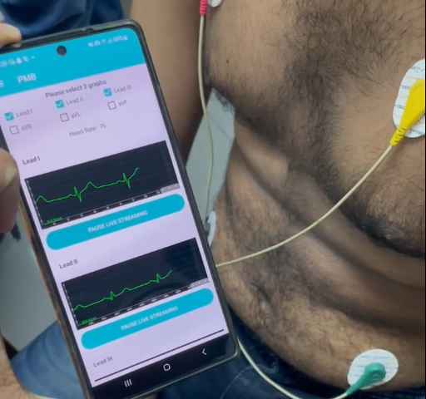
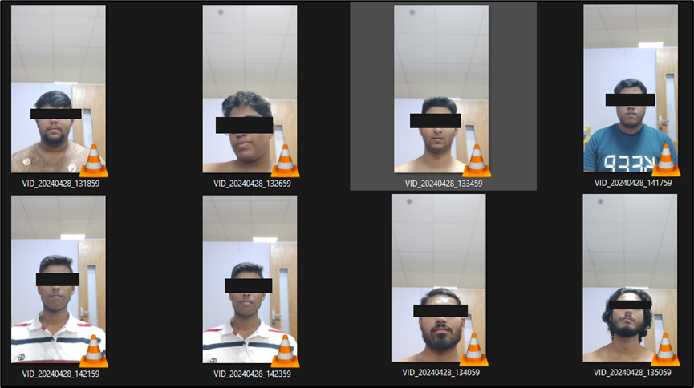
Data collection and Pre-processing
Creation of dataset
(a) Data collection
(b) Simultaneous capturing of ECG signals and facial recording
5/7/2024
23
IT21138386 | Wijeratne D.M.S.D | R24-019
Notes:
In order to proceed with the facial analysis, there was no publicly available datasets, therefore, together with Pulz Solutions, we created our own dataset with the consent of the participants
Change slide

Slide 24
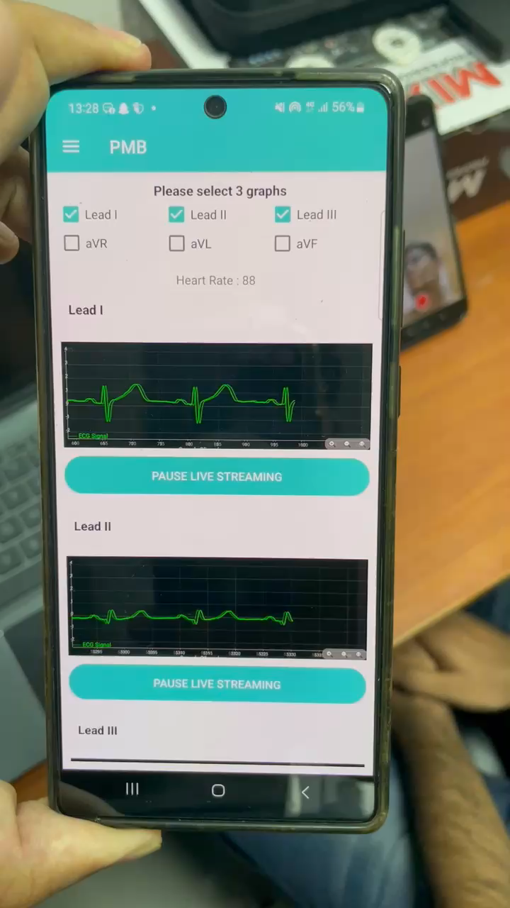
Data collection and Pre-processing
Creation of dataset
(a) Simultaneous capturing of ECG signals and facial recording
5/7/2024
24
IT21138386 | Wijeratne D.M.S.D | R24-019
Notes:
Here we can see a short video of how the dataset was created
Change slide

Slide 25
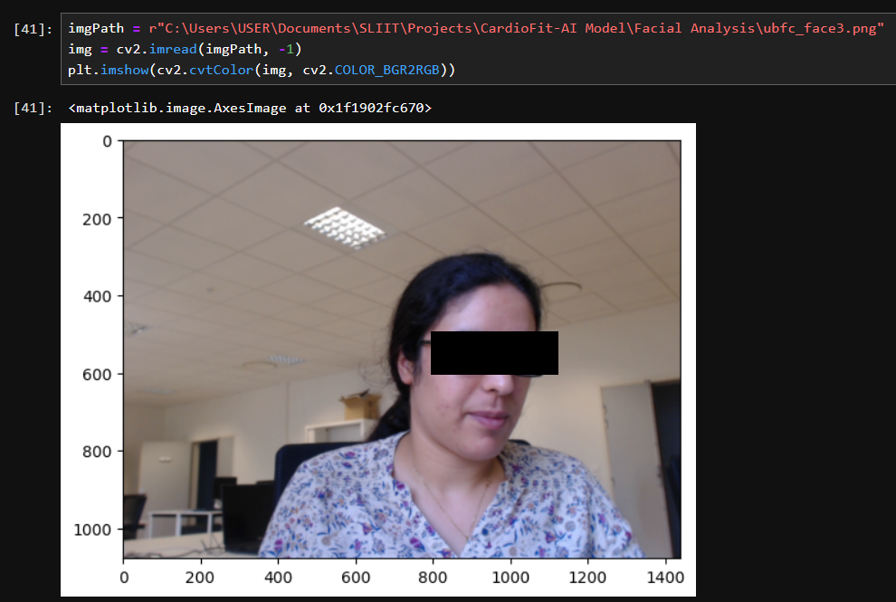
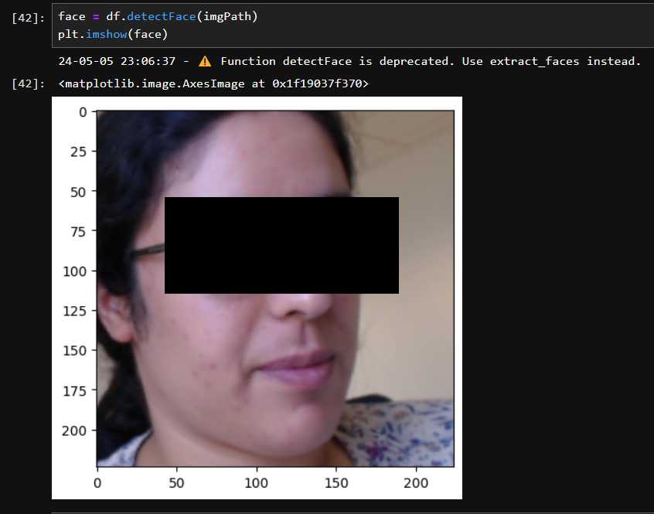
Data collection and Pre-processing
Preprocessing
(a) Pre-processing to identify facial region
5/7/2024
25
IT21138386 | Wijeratne D.M.S.D | R24-019
Notes:
Once a facial recording is captured, the facial region needs to be identified since that is the area of interest. I have made use of DeepFace library to do that.
Change slide

Slide 26
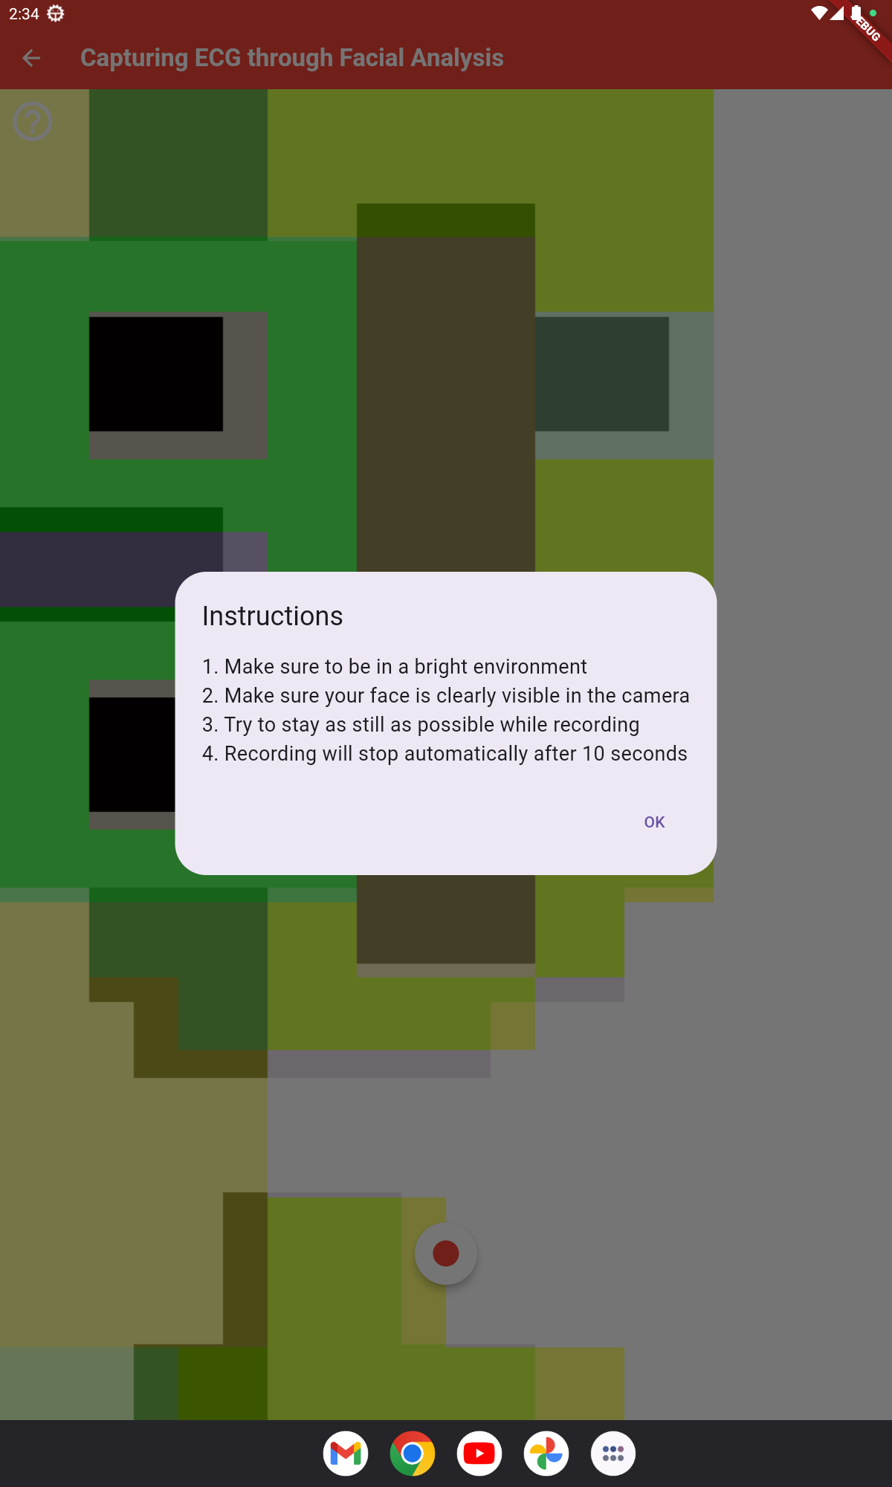
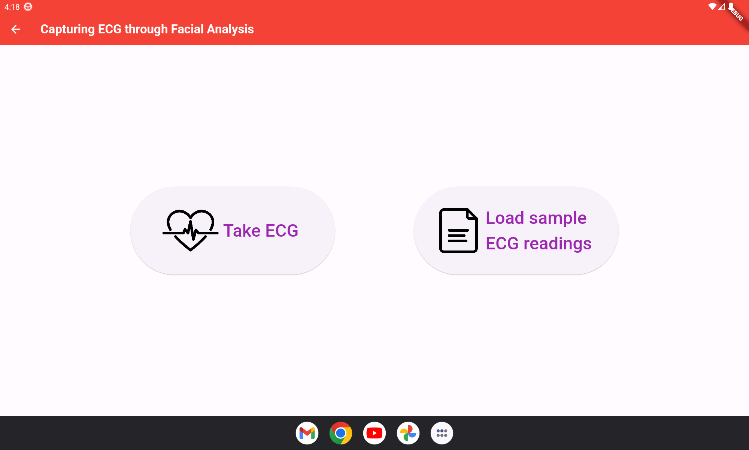
Displaying of results in mobile application
Facial Analysis – App Development UI
(a) ECG capturing options screen
(b) ECG capturing screen
5/7/2024
26
IT21138386 | Wijeratne D.M.S.D | R24-019
Notes:
Also these are some of the UI I have developed that will be used to capture the facial recording.
Change slide

Slide 27
Research Questions &Objectives
RESEARCH QUESTIONS:
How to obtain all 12 Leads of ECG signal from Lead II ECG?
How to develop CardioFit’s Modified Attention U-net model?
How to obtain Lead II ECG signal from facial recordings?
SPECIFIC OBJECTIVE:
Reconstruction of entire 12-Lead ECG from Lead II-ECG
SUB OBJECTIVES:
Identification of facial region.
Extraction of physiologically related features from the face.
Generation of ECG signals.
Creation of a tablet device-based system to visualize ECG data.
5/7/2024
27
IT21138386 | Wijeratne D.M.S.D | R24-019
Notes:
Based on all these information, my research question is ___, my specific is the ___ and the sub objectives are ____.
(change slide)

Slide 28
Progress of the Project
Identification of facial region.
Generation of entire 12 Lead ECG using Lead II ECG signal.
Creation of a tablet device-based system to visualize ECG data
IT21138386 | Wijeratne D.M.S.D | R24-019
Notes:
And out of those I have completed ____.
For my future implementations I have the extraction of the physiologically related features from the face to generate Lead II ECG.
(change slide)

Slide 29
Future Developments
Extraction of physiologically related features from the face to generate Lead II ECG.
IT21138386 | Wijeratne D.M.S.D | R24-019
Notes:
For my future implementations I have the extraction of the physiologically related features from the face to generate Lead II ECG.
(change slide)

Slide 30

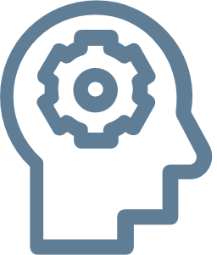

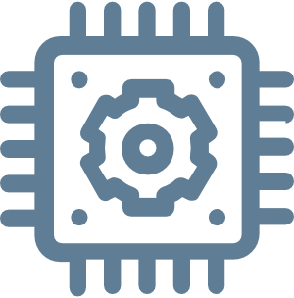
Technologies
Technologies
Algorithms
Frameworks
Techniques
Flutter
Firebase
Jupiter Notebook
Python
TensorFlow
Keras
OpenCV
Kaggle Notebook
DeepFace
Flask Server
Convolutional Neural Networks (CNN)
Generative Adversarial Network (GAN)
Attention U-Net [3]
Feature selection
IT21138386 | Wijeratne D.M.S.D | R24-019
Notes:
These are my technologies, the main ones being tensorflow, keras, OpenCV and DeepFace
(change slide)

Slide 31
Functional & Non-Functional Requirements
Functional Requirements:
Non-Functional Requirements:
High accuracy of the generated Lead II ECG.
Generation of 10-second Lead II ECG reading.
Highly accurate reconstructed 11 remaining ECG leads with 10-second duration.
Quick reconstruction of 12 Leads
Intuitive and responsive interfaces.
Application with high level of reliability.
Confidentiality and integrity of the ECG and other data.
Regular backups of data to prevent data loss.
IT21138386 | Wijeratne D.M.S.D | R24-019
Notes:
And these are my system Functional, Non-Functional, System, and User Requirements, some of the main requirements being the fast reconstruction of accurate 12 lead ECG
(change slide)

Slide 32
References
[1] A. Bayés de Luna, M. Fiol‐Sala, and E. M. Antman, Eds., “The 12‐Lead ECG in ST Elevation Myocardial Infarction,” Jan. 2007, Published, doi: 10.1002/9780470750964.
[2] “Cardiovascular diseases,” Jun. 11, 2019. https://www.who.int/health-topics/cardiovascular-diseases#tab=tab_1
[3] A. Garg, V. V. Venkataramani, and U. D. Priyakumar, “Single-Lead to Multi-Lead Electrocardiogram Reconstruction Using a Modified Attention U-Net Framework,” 2023 International Joint Conference on Neural Networks (IJCNN), Jun. 2023, Published, doi: 10.1109/ijcnn54540.2023.10191213.
IT21138386 | Wijeratne D.M.S.D | R24-019
Notes:
And finally, these are my references. With that being said I conclude my component and I would like to hand over the presentation to Poorna

Slide 33
IT21126888 | Senadheera P.V.P.P
Specialization : Software Engineering
IT21126888 | Senadheera P.V.P.P | R24-019

Slide 34
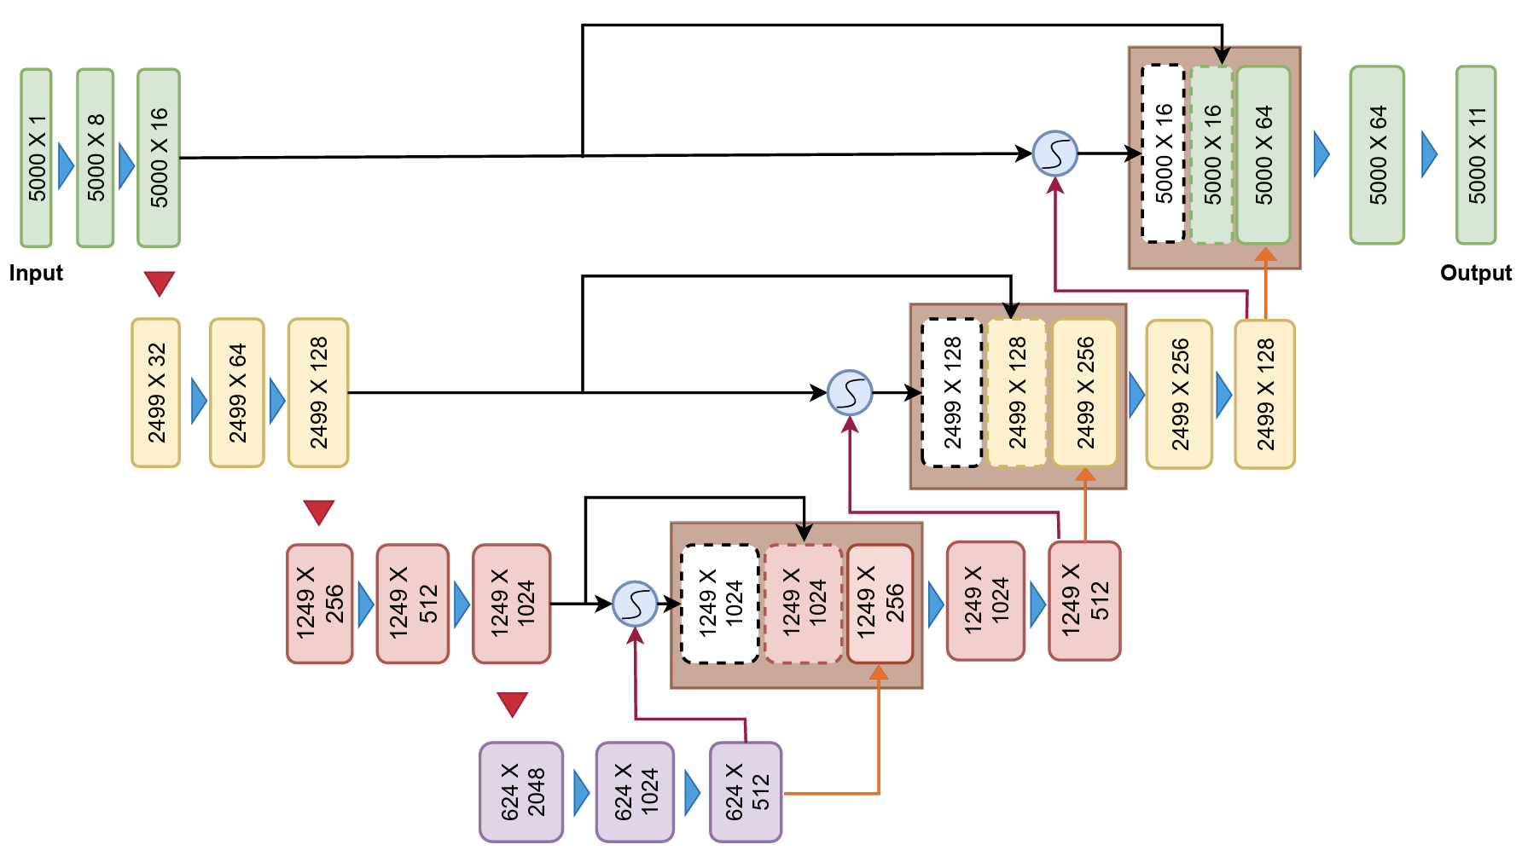
Decoder
Key Components
Skip Connections
Gating Signals
Up Sampling Layers
Attention Gates
Objective
Reconstruction Process
IT21126888 | Senadheera P.V.P.P | R24-019

Slide 35
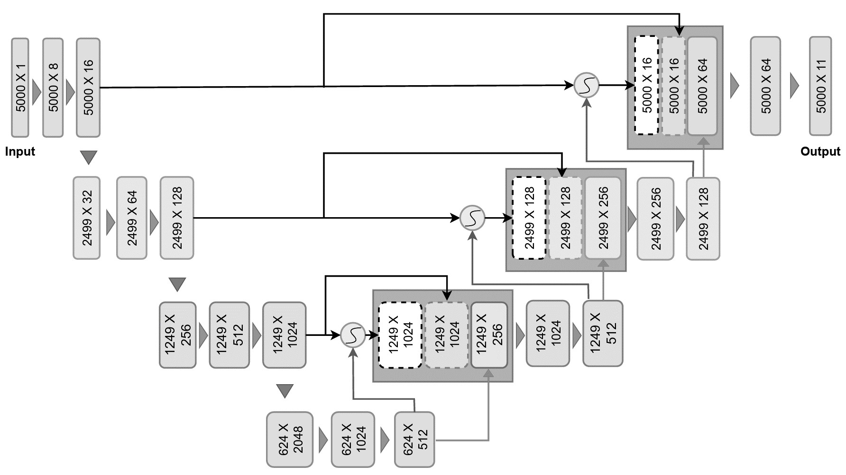
Decoder
Skip Connections
Comes from encoder
Preserves raw signal information
Recovers the lost
IT21126888 | Senadheera P.V.P.P | R24-019

Slide 36
Decoder
Gating Signals
Processed signals
Contains most relevant features
IT21126888 | Senadheera P.V.P.P | R24-019

Slide 37
Decoder
Up Sampling Layers
1D Transposed Convolutional Layers
Helps for reconstruction process
IT21126888 | Senadheera P.V.P.P | R24-019

Slide 38

Decoder
Attention Gates
Accepts skip connection and gating signal
Executes the learning & reconstruction process
IT21126888 | Senadheera P.V.P.P | R24-019

Slide 39
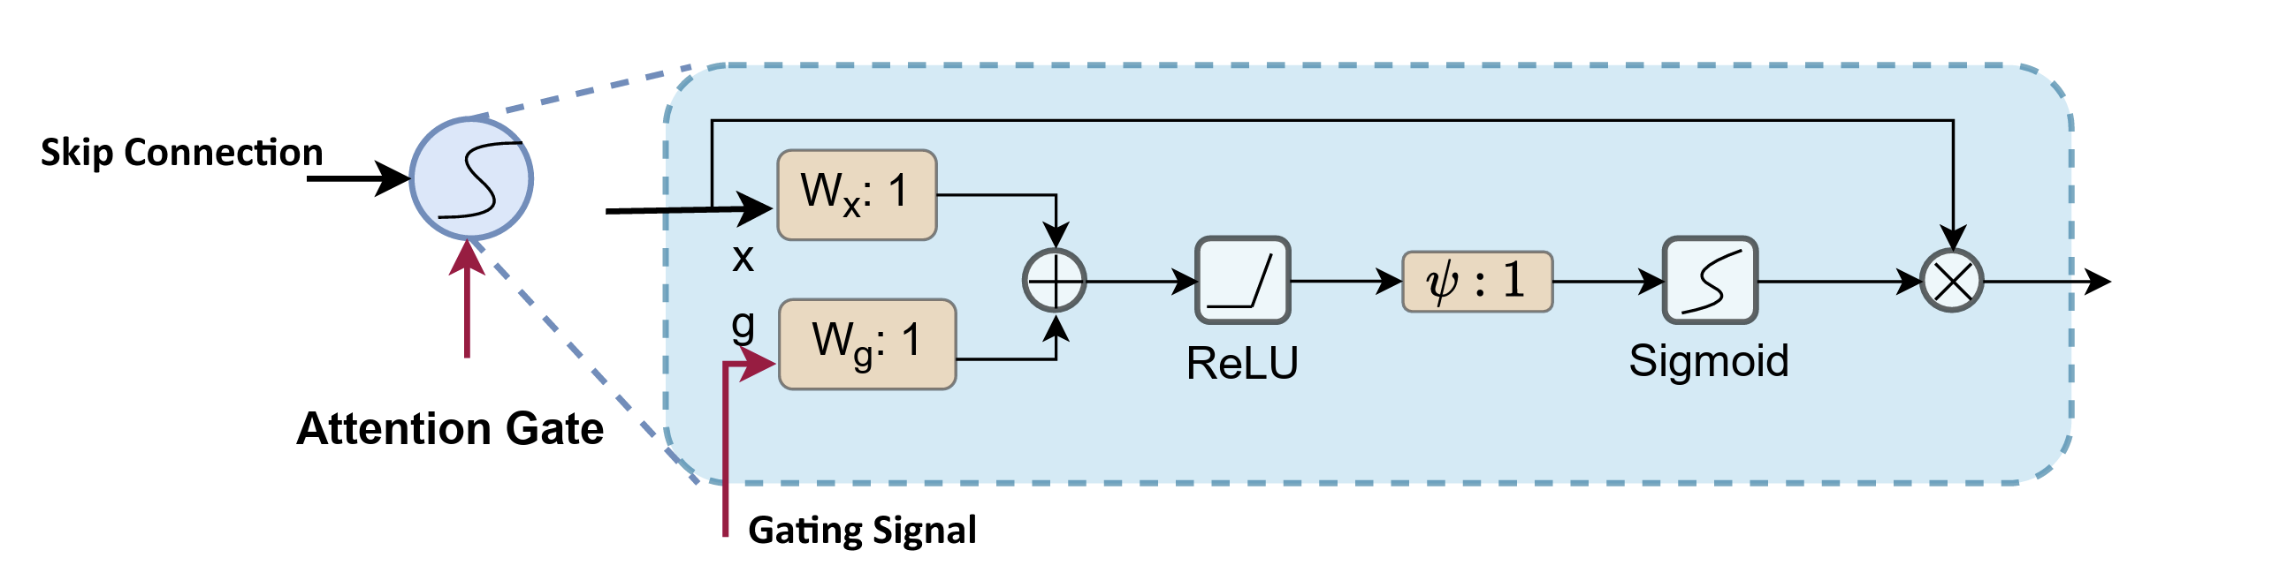
Decoder
Attention Gate
Concatenation → ReLU Activation → Up Sampling → Sigmoid Activation → Multiplication
IT21126888 | Senadheera P.V.P.P | R24-019
Notes:
ReLU for image segmentation process

Slide 40
Research Questions &Objectives
RESEARCH QUESTIONS:
How to obtain all 12 Leads of ECG signal from Lead II ECG?
How to develop CardioFit’s Modified Attention U-net model?
How to obtain Lead II ECG signal from palms?
SPECIFIC OBJECTIVE:
Generate 12 lead ECG signal with high level of accuracy in comparison to the traditional ECG signal
SUB OBJECTIVES:
Determine the optimal ECG lead to obtain the other leads accurately.
Training the model to re-construct the remaining 11 ECG leads.
Design and implement a smart tablet-based platform for ECG viewing, facilitating user-friendly access and interpretation of cardiac data.
Identification of cardiac rhythm through the analysis of palms.
IT21126888 | Senadheera P.V.P.P | R24-019

Slide 41
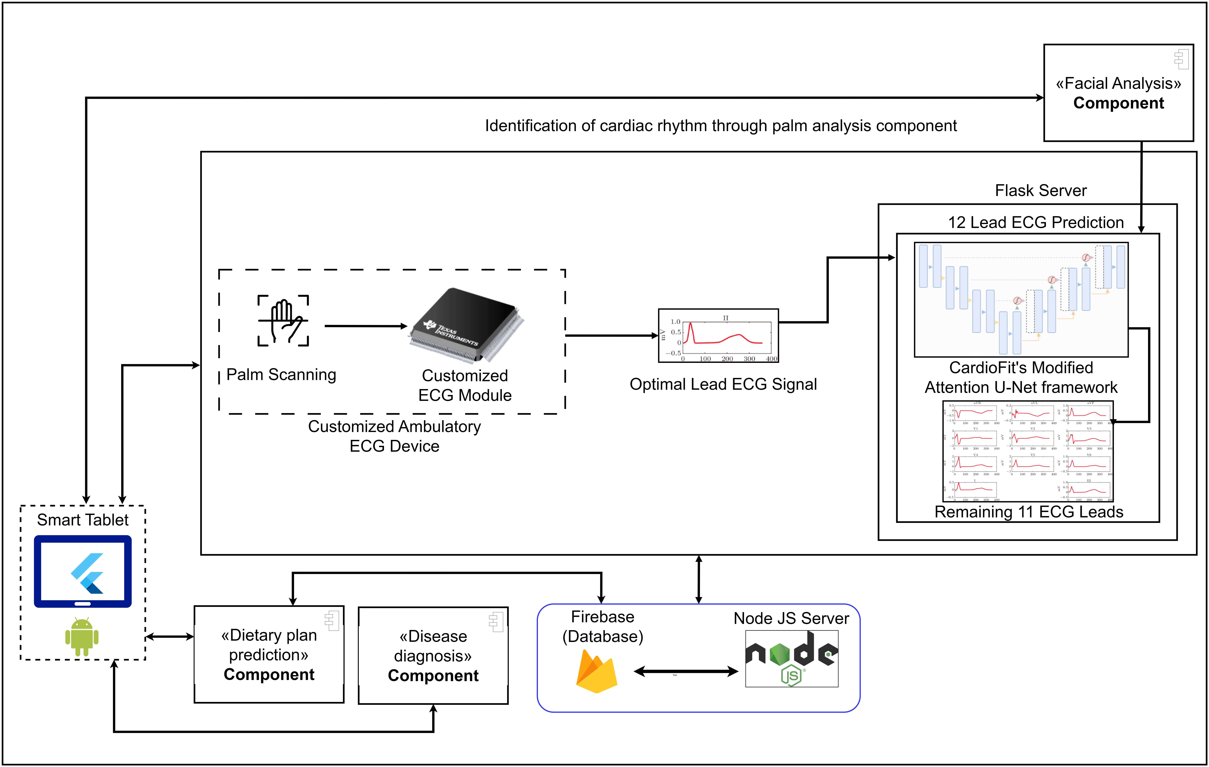
Methodology
IT21126888 | Senadheera P.V.P.P | R24-019

Slide 42
Progress of the Project
Data pre-processing
Implement the model architecture
Train the deep learning model
Deploy the deep learning model on Flask Server
Generate 12 lead ECG signal with high level of accuracy in comparison to the traditional ECG signal
Display the results in mobile application
IT21126888 | Senadheera P.V.P.P | R24-019

Slide 43
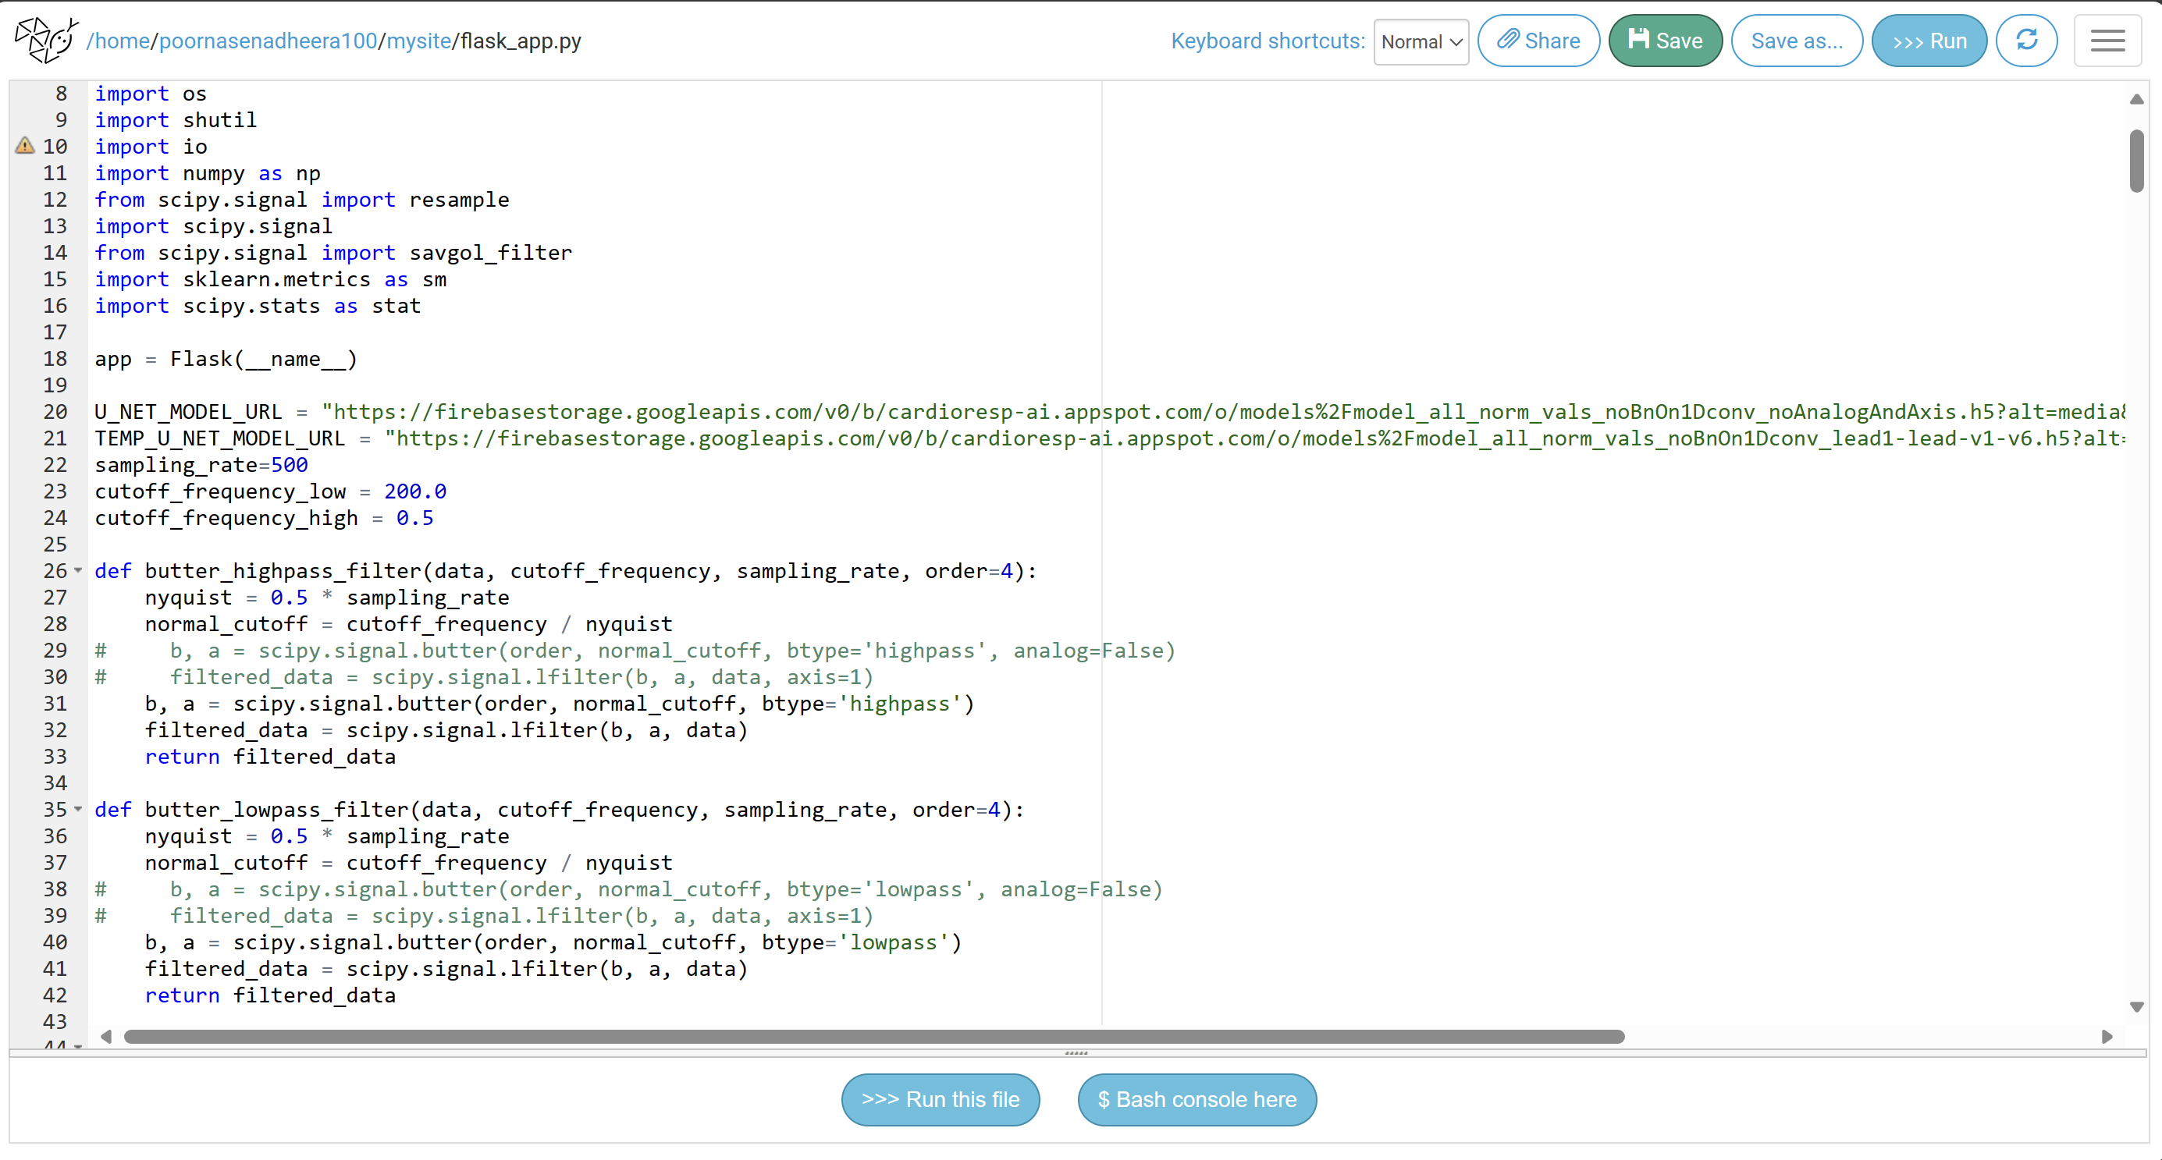
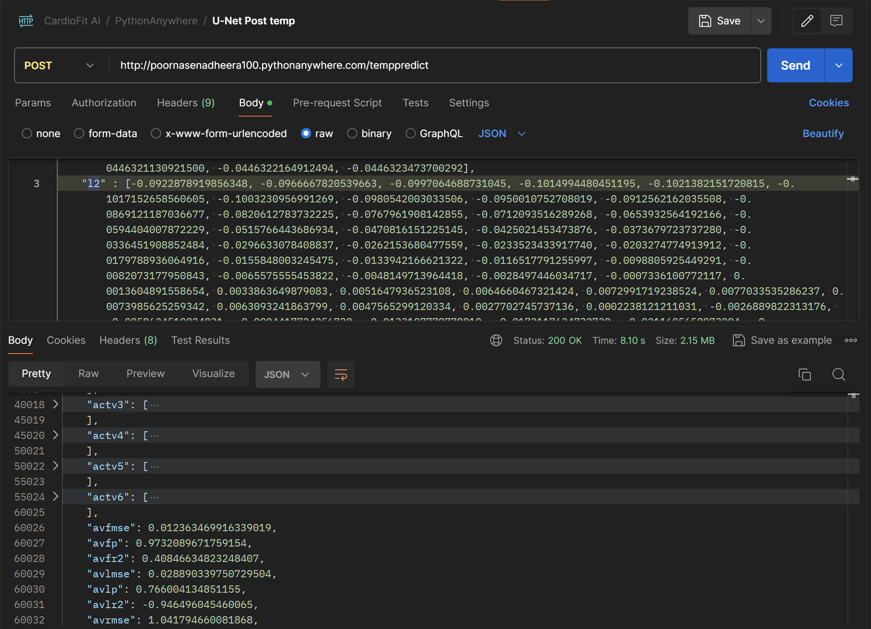
Flask Server Deployment
IT21126888 | Senadheera P.V.P.P | R24-019

Slide 44
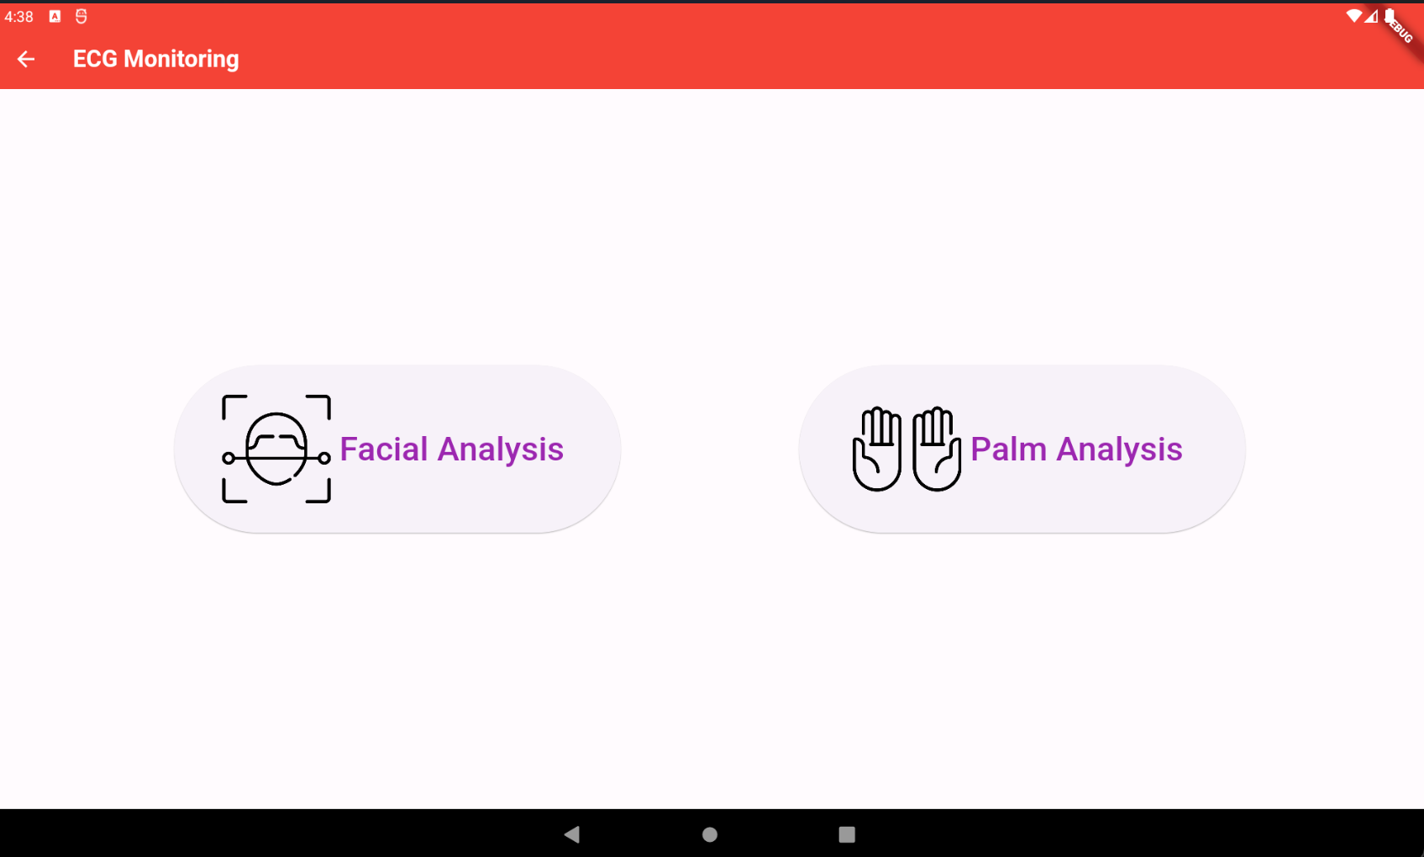
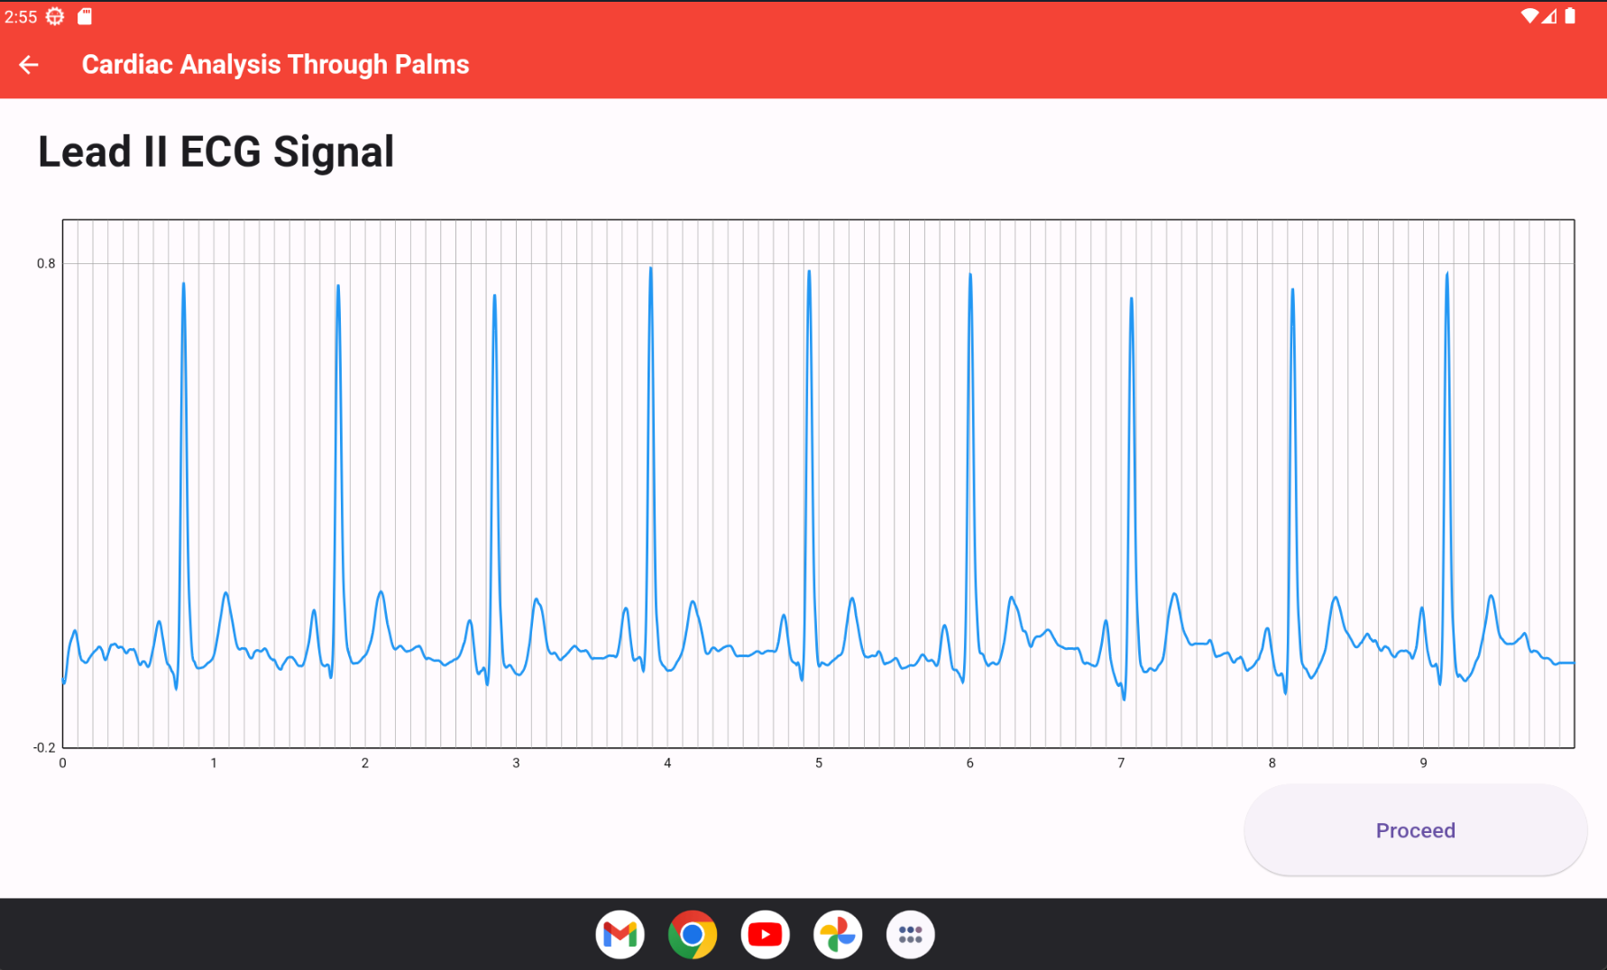
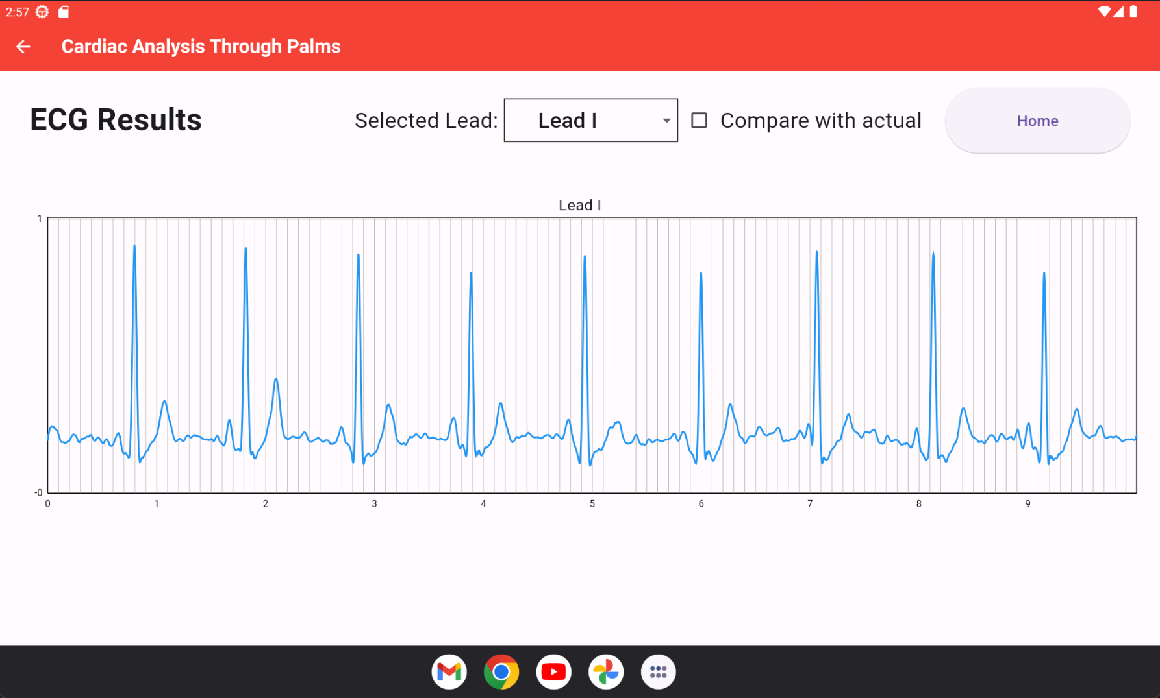
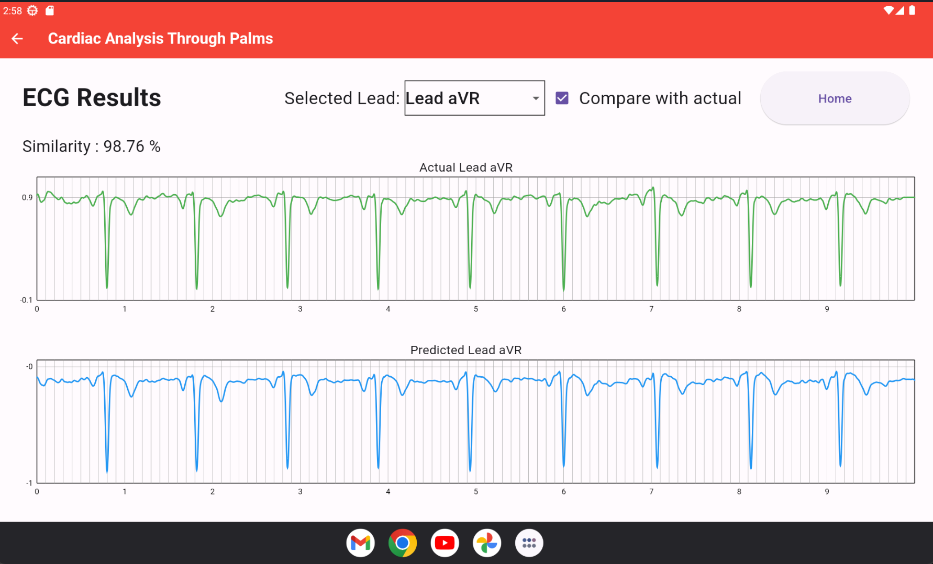
Display The Results in Mobile Application
IT21126888 | Senadheera P.V.P.P | R24-019

Slide 45
Technologies Used
Technologies
Algorithms
Frameworks
Techniques
Firebase
Python
TensorFlow
Keras
Jupyter Notebook
Kaggle Notebook
Flask Server
Convolutional Neural Networks (CNN)
Flutter
Attention U-Net [5]
Feature selection
IT21126888 | Senadheera P.V.P.P | R24-019

Slide 46
Future Works
Reading the relevant ECG lead from palms using dry electrodes.
Finalize the user interfaces in mobile application
IT21126888 | Senadheera P.V.P.P | R24-019

Slide 47
Functional & Non-Functional Requirements
Functional Requirements:
Non-Functional Requirements:
The optimal ECG lead obtained from the palms should be displayed in real-time.
The optimal ECG lead should be recorded for 10 seconds.
The remaining 11 leads should be acquired with high accuracy and displayed.
Interfaces should be User-friendly
The application should be reliable
Results should be more efficient
IT21126888 | Senadheera P.V.P.P | R24-019
Notes:
And these are my system Functional, Non-Functional, System, and User Requirements, some of the main requirements being the fast reconstruction of accurate 12 lead ECG
(change slide)

Slide 48
References
[1] Yongning Zou and Zhenyu Guo, "A Palm Pilot based pocket ECG recorder," Proceedings 2000 IEEE EMBS International Conference on Information Technology Applications in Biomedicine. ITAB-ITIS 2000. Joint Meeting Third IEEE EMBS International Conference on Information Technol, Arlington, VA, USA, 2000, pp. 110-112, doi: 10.1109/ITAB.2000.892359.
[2] F. Chiarugi, M. Spanakis, P. J. Lees, C. E. Chronaki, M. Tsiknakis and S. C. Orphanoudakis, "ECG in your hands: a multi-vendor ECG viewer for personal digital assistants," Computers in Cardiology, 2003, Thessaloniki, Greece, 2003, pp. 359-362, doi: 10.1109/CIC.2003.1291166.
[3] Hoffmann, K. P., & Ruff, R. (2007). Flexible dry surface-electrodes for ECG long-term monitoring. Annual International Conference of the IEEE Engineering in Medicine and Biology Society. IEEE Engineering in Medicine and Biology Society. Annual International Conference, 2007, 5740–5743. https://doi.org/10.1109/IEMBS.2007.4353650
[4] André Lourenço, Ana Fred and Hugo Silva, “Palm-based ECG biometrics”, academia.edu, 2011.
[5] A. Garg, V. V. Venkataramani, and U. D. Priyakumar, “Single-Lead to Multi-Lead Electrocardiogram Reconstruction Using a Modified Attention U-Net Framework,” 2023 International Joint Conference on Neural Networks (IJCNN), Jun. 2023, Published, doi: 10.1109/ijcnn54540.2023.10191213.
IT21126888 | Senadheera P.V.P.P | R24-019

Slide 49
IT21127946| Christy H.M
Specialization : Software Engineering

Slide 50
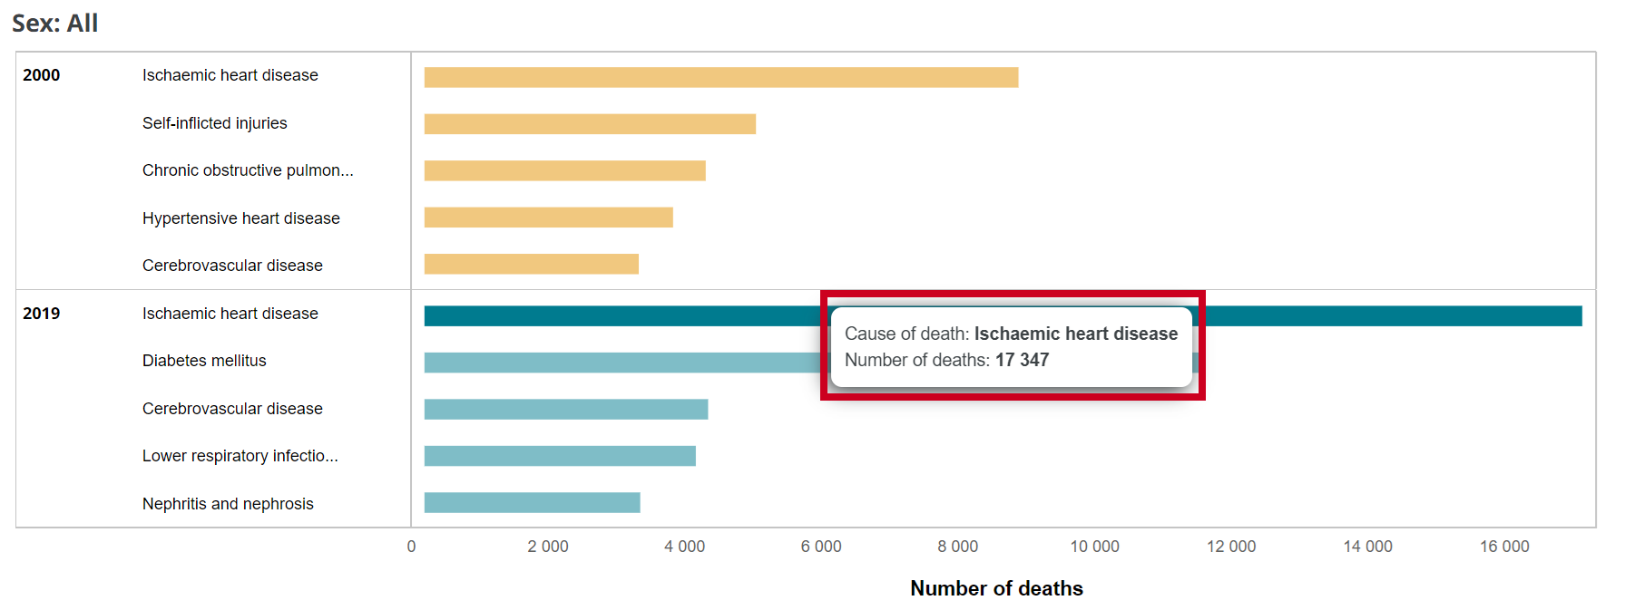
Background
Count = 17,347
Source - https://platform.who.int/mortality/countries/country-details/MDB/sri-lanka
IT21127946 | Christy H.M | R24-019

Slide 51

Research Problem
Ø How to avoid potential loss of lives via the prevention of the misdiagnosis of cardiac diseases, and make informed decision on patient admission for optimal care.
IT21127946 | Christy H.M | R24-019

Slide 52
Objectives
Step 1
Step 2
Step 3
Step 6
Preprocess dataset.
Train a model and classify diseases.
Display predicted results.
Step 4
Provide medical prompts of patient admission.
Step 5
Inform loved ones regarding patient's status.
Test the application with wide combination of data inputs.
IT21127946 | Christy H.M | R24-019

Slide 53

Methodology
IT21127946 | Christy H.M | R24-019

Slide 54
Methodology
IT21127946 | Christy H.M | R24-019

Slide 55

Data Collection
PTB-XL

Slide 56



Deployment as a Web Service – Flask Server
POSTMAN RESULTS
FLASK SERVER

Slide 57
Deployment as a Web Service – Flask Server
POSTMAN RESULTS
FLASK SERVER

Slide 58
Identified Cardiac Arrhythmias
Myocardial Infarction
Cardial Conduction Disorders
Ischemic Heart Disease
01
02
03
IT21127946 | Christy H.M | R24-019

Slide 59

Myocardial Infarction
01
Occurs due to sudden interruption in blood supply
Could even lead to death.
Requires immediate medical supervision.
IT21127946 | Christy H.M | R24-019

Slide 60

Cardial Conduction Disorders
⁰²
Abnormalities in the electrical conduction system of the heart.
Disturbances in the rhythm of the heart.
Covers Right Bundle Branch Block, Left Bundle Branch Block and etc.
IT21127946 | Christy H.M | R24-019

Slide 61

Ischemic Heart Disease
03
Caused by narrowed vessels that restricts blood flow to the heart muscle.
Could even lead to chest pain or heart attack.
Requires medical supervision to improve heart health and avoid any other complications.
IT21127946 | Christy H.M | R24-019

Slide 62


Mobile Application

Slide 63
Functional and Non-Functional Requirements
Functional
Non-Functional
Should be able to retrieve and preprocess the 12 lead ECG.
Should be able to accurately predict a range of cardiac diseases defined.
Should be able to send real-time notifications to designated loved ones.
Provide actionable recommendations like prompt medical consultation
The application should be user- friendly and easy to use.
Should be able to accurately predict a range of cardiac diseases defined.
Applications should be reliable enough to be used.
IT21127946 | Christy H.M | R24-019

Slide 64

Technologies Used
Algorithms
Techniques
Technologies
Convolutional Neural Networks (CNN)
Feature selection
Flutter
Firebase
Python
TensorFlow
Keras
Jupyter Notebook
Kaggle Notebook
Flask Server

Slide 65
Progress of Project
Acquire and preprocess 12 lead ECG for better precision of results.
Train a model for the purpose of identifying diseases.
Develop the mobile application in which the predicted disease is displayed.
IT21127946 | Christy H.M | R24-019

Slide 66
Future Developments
Provide tailored recommendation on patient admission.
Develop a mechanism to inform the loved ones about the status of the patient.
Test the application with a wide variety of data inputs.
IT21127946 | Christy H.M | R24-019

Slide 67

References

Slide 68

IT21134180 | VIHANSA S.A.S​
Specialization : Software Engineering

Slide 69
Eat Smart, Protect Your Heart
10,000,000
Cardiovascular Related Deaths
A Review of Healthy Dietary Choices for Cardiovascular Disease: From Individual Nutrients and Foods to Dietary Patterns
IT21134180 | Vihansa S.A.S | R24-019
Notes:
heart disease is the leading cause of death globally.
It is a shocking statistic,
but the power to change it lies partly on our plates!​
We have significant control over our heart health,
and a big part of that is through what we choose to eat. Eating a balanced diet rich in fruits, vegetables, whole grains, and lean protein can significantly lower your risk of heart disease.​
In my component I aim to propose a dietary advice considering patient medical report, and BMI and gender

Slide 70

Eat Smart, Protect Your Heart
IT21134180 | Vihansa S.A.S | R24-019
Notes:
heart disease is the leading cause of death globally.
It is a shocking statistic,
but the power to change it lies partly on our plates!​
We have significant control over our heart health,
and a big part of that is through what we choose to eat. Eating a balanced diet rich in fruits, vegetables, whole grains, and lean protein can significantly lower your risk of heart disease.​
In my component I aim to propose a dietary advice considering patient medical report, and BMI and gender

Slide 71
RESEARCH PROBLEM
How to collect adequate information to analyze patient medical reports required to propose dietary advice?
How to propose a customized dietary advice considering the patient medical report, BMI and cardiac health?
IT21134180 | Vihansa S.A.S | R24-019
Notes:
My research problems are,
Analyzing patient medical report and identify its abnormalities and
With proper analysis of user's health pattern , provide customized dietary advice.

Slide 72

RESEARCH OBJECTIVES
Generating a customized dietary advice based on users ECG, medical report results and BMI​
01
Identify the analysis made by doctors observing patient health reports.
02
Collect necessary information to propose dietary advice in a customized manner.
03
Implement a proper methodology to scan and extract relevant components from users' medical reports and display its analysis
04
Based on the inputs obtained from user medical reports, BMI and Cardiac Health propose customize dietary advice
Notes:
My Research Objective is to Generating a customized dietary advice based on users ECG, medical report results and BMI​
To achieve my objective, the supporting sub objectives are,
1. Scan patient medical reports and extract the required components
2. Analyze the medical report and capture its abnormalities
3. Collect dietary advice matching to various patterns in BMI and Medical conditions
4. Display the customized dietary advice to the user.

Slide 73








Cardiac Arrythmia
Database
Server
Customized Dietary Advice
OCR Technology
Notes:
Next, I would like to explain about my system diagram,
​In my component, I scan a patient medical report such as Full blood count and Urine full report and via Optical character Recognition technology, for this I am using an API from OCR space. Next I ,​
filter out the irrelevant component from the scanned text, obtain the relevant components in the report ​with the use of regExp function.
Analyze the results obtained and predict the diagnosis of the report. ​
Based on the obtained inputs which is Report diagnosis, ECG prediction obtained from my colleagues and BMI of the patient I intend to generate a customize dietary advice.​

Slide 74

Methodology
IT21134180 | Vihansa S.A.S | R24-019
Notes:
Next, I would like to explain about my system diagram,
​In my component, I scan a patient medical report such as Full blood count and Urine full report and via Optical character Recognition technology, for this I am using an API from OCR space. Next I ,​
filter out the irrelevant component from the scanned text, obtain the relevant components in the report ​with the use of regExp function.
Analyze the results obtained and predict the diagnosis of the report. ​
Based on the obtained inputs which is Report diagnosis, ECG prediction obtained from my colleagues and BMI of the patient I intend to generate a customize dietary advice.​

Slide 75
Progress of Project
Collect information for medical report analysis
Initiated requirement gathering of dietary advice.
Predict abnormalities observed in medical report
IT21134180 | Vihansa S.A.S | R24-019
Notes:
I have completed, requirement gathering for accurate diagnosis made by doctors observing patient medical report.
Next I have build a mobile application which could Scan and analyzing patient medical report, and display its abnormalities. Further I have built interface to calculate patient BMI.
And currently I have initiated requirement gathering to complete my other objective, proposing dietary advices
For my evidence of completion, I have built a mobile application which scans patients medical report using OCR technology, identify and display its abnormalities.

Slide 76
Future Work
Collect necessary information for proposing dietary advice customized to specific users.
Display the dietary advice for the user based on the medical reports uploaded, Users BMI and Cardiac Health.
Pop up timely notification to get user feedback on proposed dietary solution.
IT21134180 | Vihansa S.A.S | R24-019
Notes:
I have completed, requirement gathering for accurate diagnosis made by doctors observing patient medical report.
Next I have build a mobile application which could Scan and analyzing patient medical report, and display its abnormalities. Further I have built interface to calculate patient BMI.
And currently I have initiated requirement gathering to complete my other objective, proposing dietary advices
For my evidence of completion, I have built a mobile application which scans patients medical report using OCR technology, identify and display its abnormalities.

Slide 77
Functional & Non-Functional Requirements
Functional Requirements:
Non-Functional Requirements:
Display the analysis made by scanning a medical report.
Propose a customized dietary advice.
Interfaces should be User-friendly
The application should be reliable
Results should be more efficient
IT21134180 | Vihansa S.A.S | R24-019
Notes:
And these are my system Functional, Non-Functional, System, and User Requirements, some of the main requirements being the fast reconstruction of accurate 12 lead ECG
(change slide)

Slide 78


DATA COLLECTING

Slide 79


MOBILE APPLICATION
IT21134180 | Vihansa S.A.S | R24-019
Notes:
Listed above are the mobile application screens that I have built of now.

Slide 80


COMMERCIALIZATION
Pulz Solutions Pvt Ltd
CEO – Mr. Pramadhi Atapattu
Notes:
For my future work,
Collect necessary information for proposing dietary advice customized to specific users.
Display the dietary advice for the user based on the medical reports uploaded, Users BMI and Cardiac Health.
Pop up timely notification to get user feedback on proposed dietary solution.
And now let me show my demonstration

